Slide 1


Slide 2


Is a provincial Association with over 2400 Member firms with over 10,000 employees
“Landscape Ontario’s mission is to be the leader in representing, promoting and fostering a favourable climate for the advancement of the horticultural industry in Ontario”

Slide 3


Is a program developed by L.O., defining our members as the GREEN Industry working together to promote the joys and benefits of plants and landscapes.
Our Motto is: ‘ Lets Landscape Ontario, with Green For Life!’

Slide 4
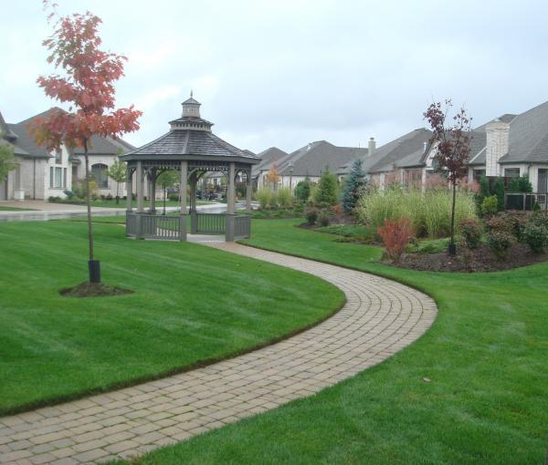
Landscape Horticulture is one of Canada’s fastest growing industries
Landscape Industry Professionals design and build healthy and aesthetically pleasing indoor and outdoor spaces. We enhance the health and well being of society.

Slide 5
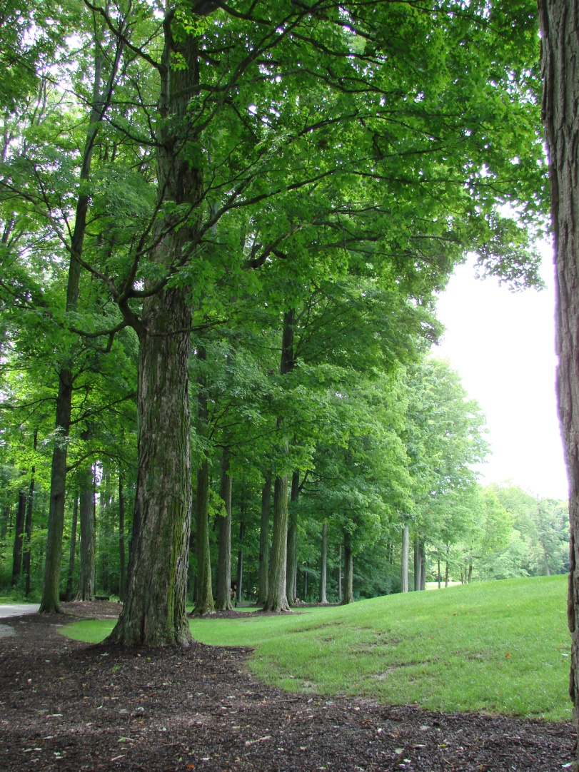
Demand for Landscape Horticulturists:
• Landscape Horticulture Industry is expected to double in size by 2021
• Today, we contribute over 14 Billion to the Canadian Economy
• Over 130,000 employed today
• Ontario Represents over 50% of the Canadian Industry.
• 50% of industry expected to retire in next 5-10 years leaving a huge gap in skilled workers
• Consumers want instant quality landscapes
• No other industry enhances the environment better!

Slide 6

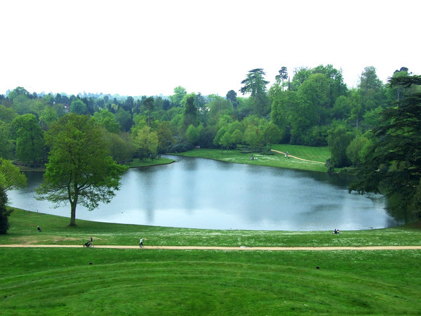
Great
opportunities
for future generations

Slide 7
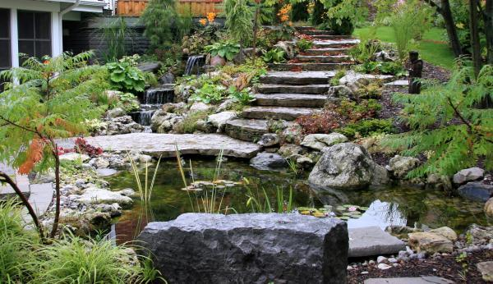
There are
Many Careers to Consider:

Slide 8
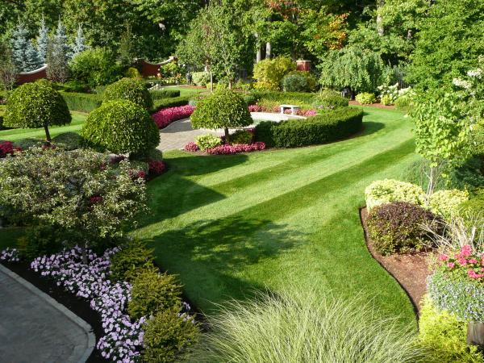
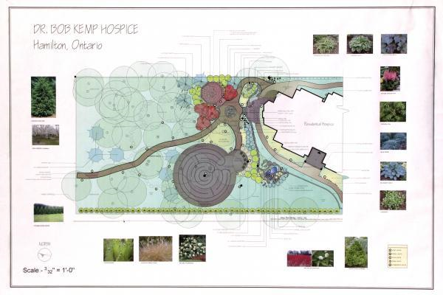
Landscape Design
“Nothing happens unless first we dream.”
Carl Sandburg

Slide 9
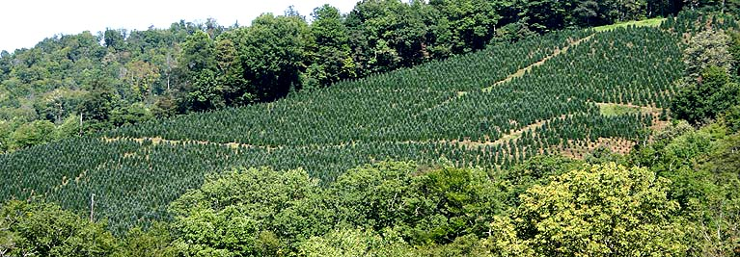

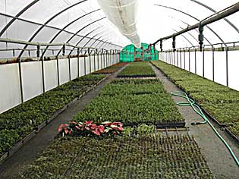
Nursery Grower / Propagator

Slide 10
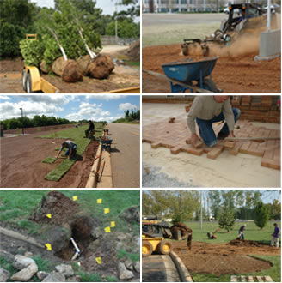
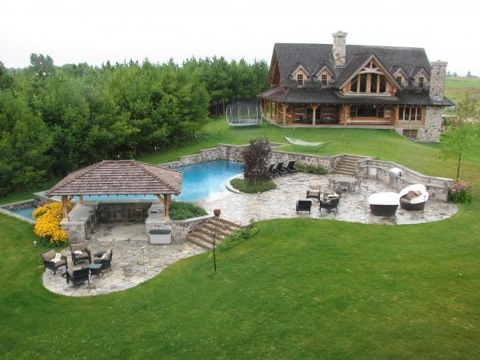
Hardscape Installation
and Softscape Installation

Slide 11

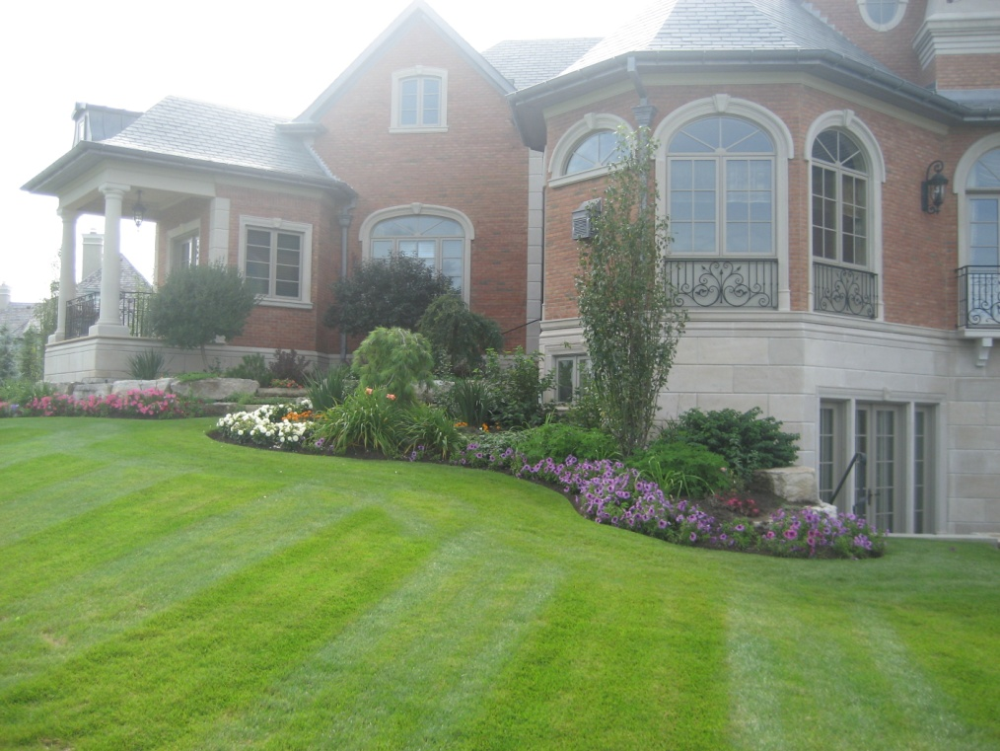
Commercial / Industrial / Residential

Slide 12
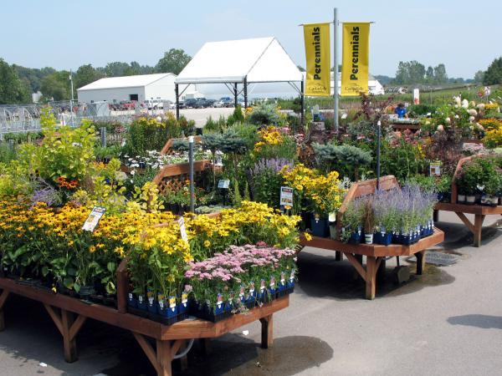
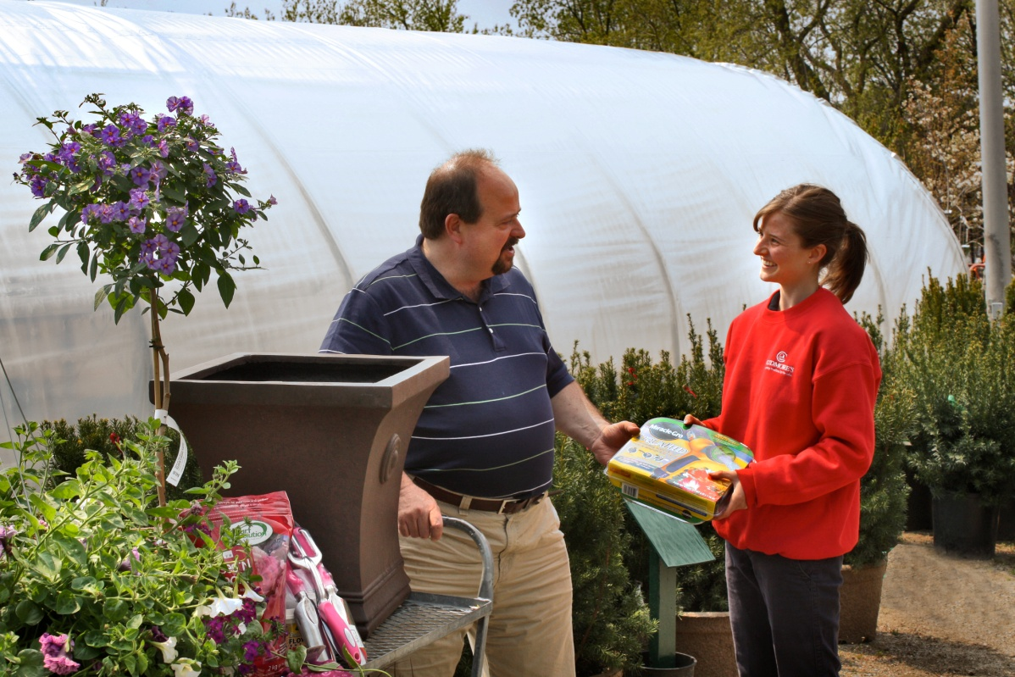
Retail Garden Centre

Slide 13
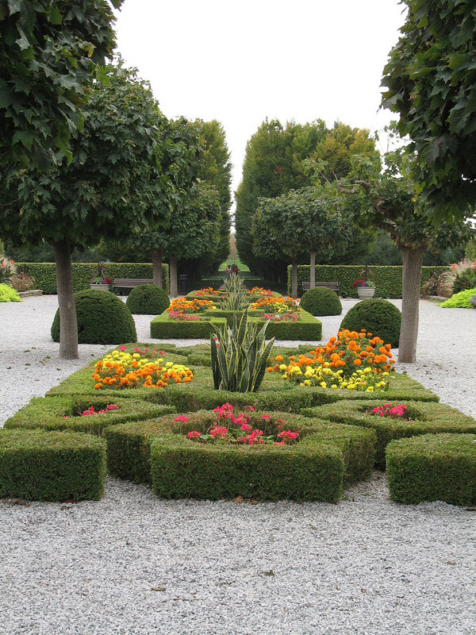
Landscape Maintenance

Slide 14
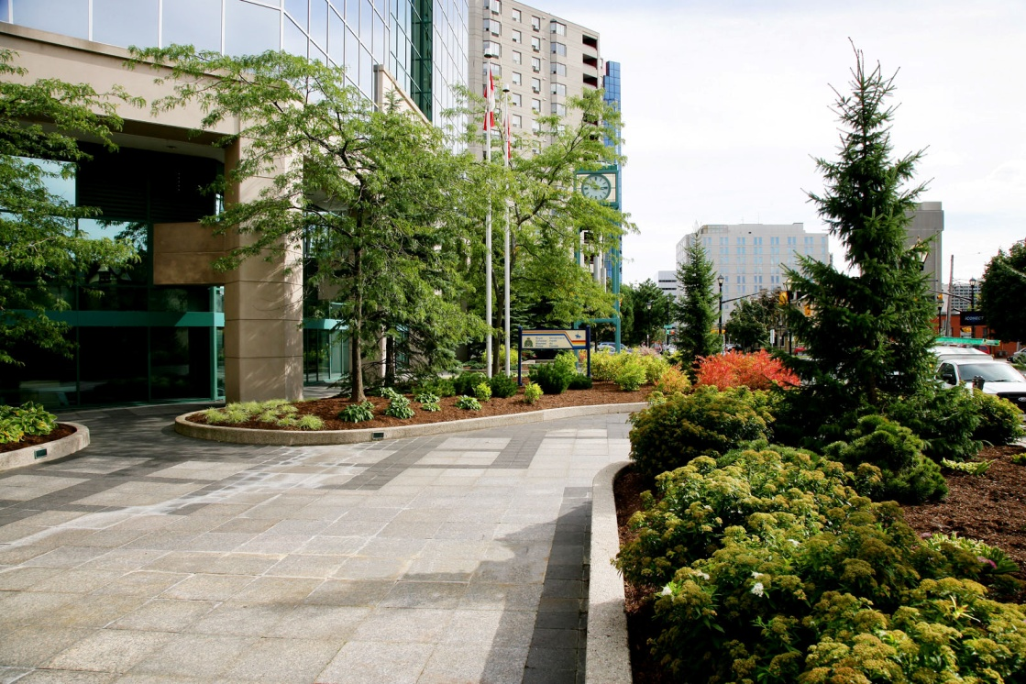
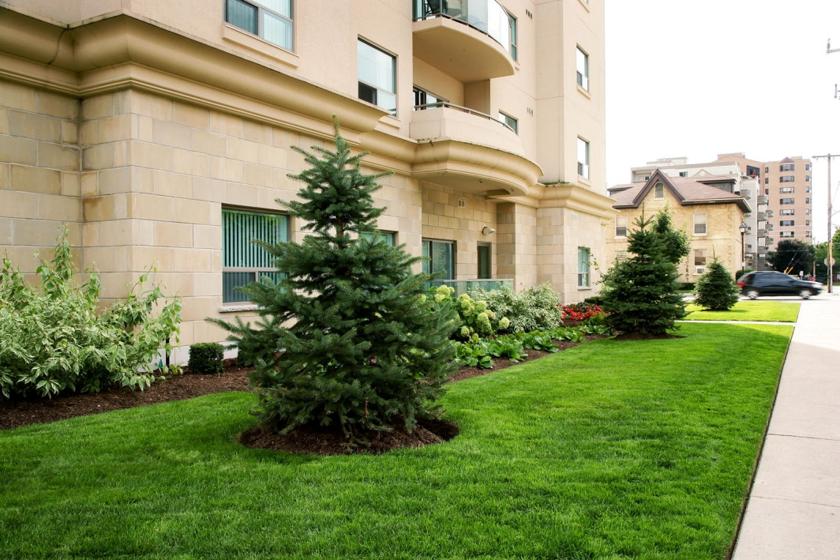
Grounds Management

Slide 15
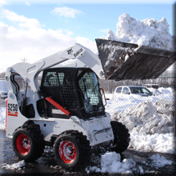
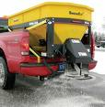


Snow Removal
Snow removal
is a 24-7 on call job!
And takes all types of equipment and man power!

Slide 16
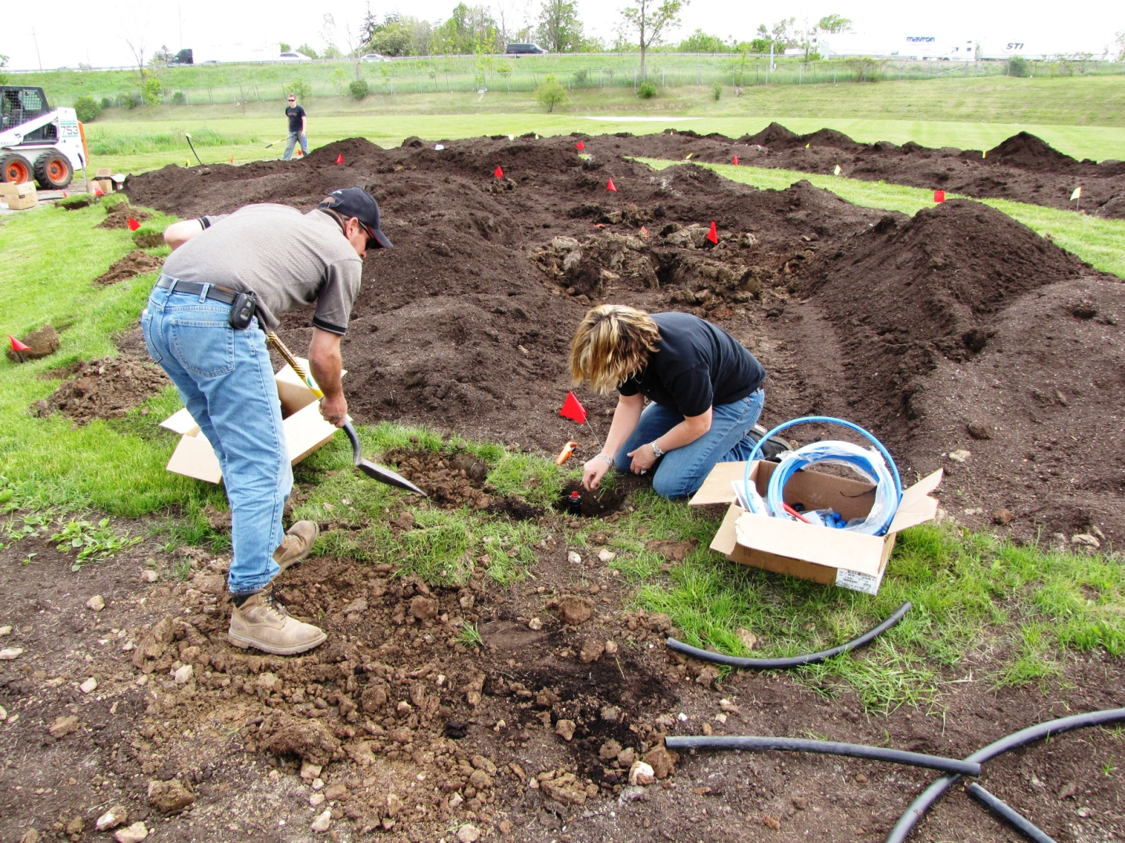
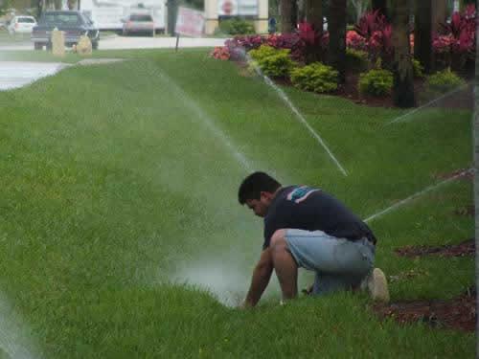
Irrigation Installation and Maintenance

Slide 17
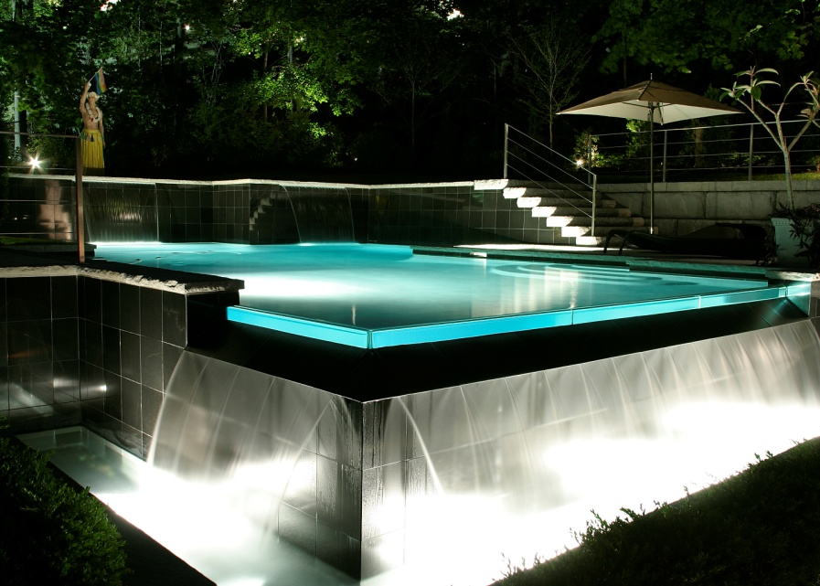


Lighting Installation and Maintenance

Slide 18
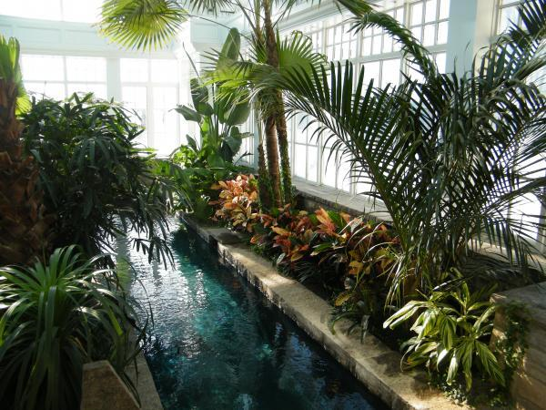
Interiorscape Installation
and Maintenance
Creating healthy indoor spaces

Slide 19
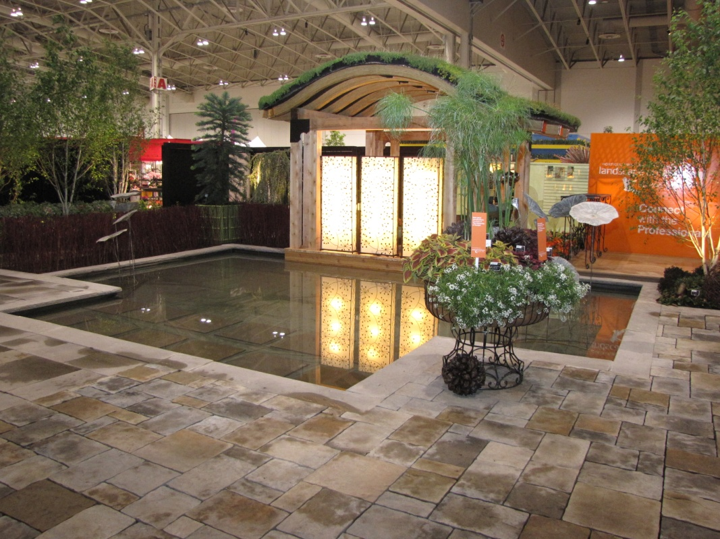
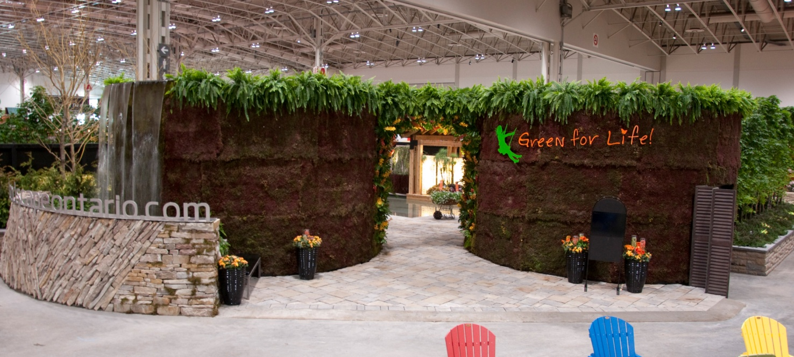
Green Roof and Living Walls

Slide 20
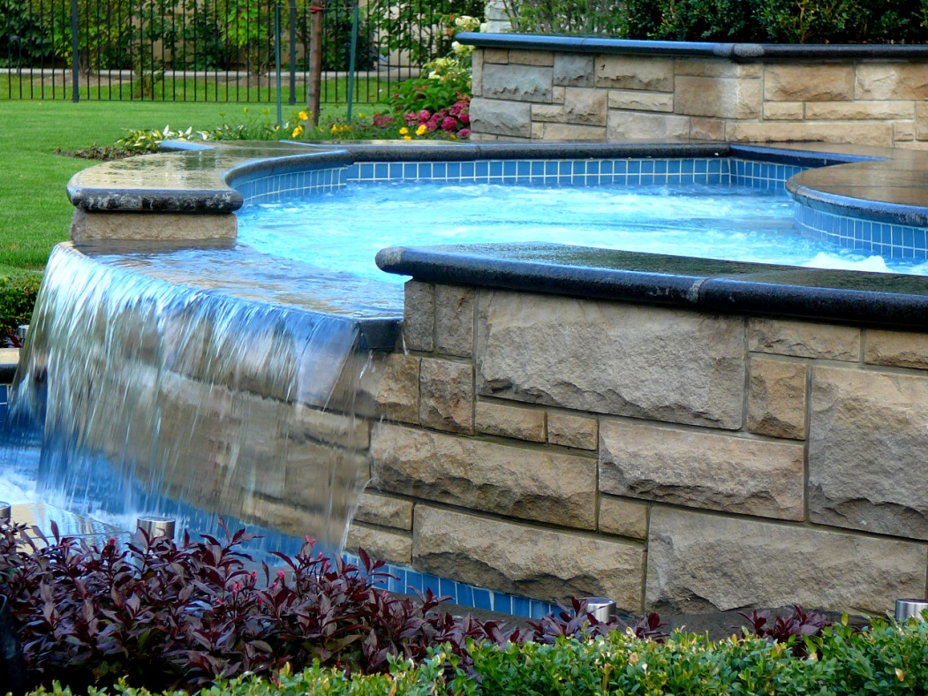
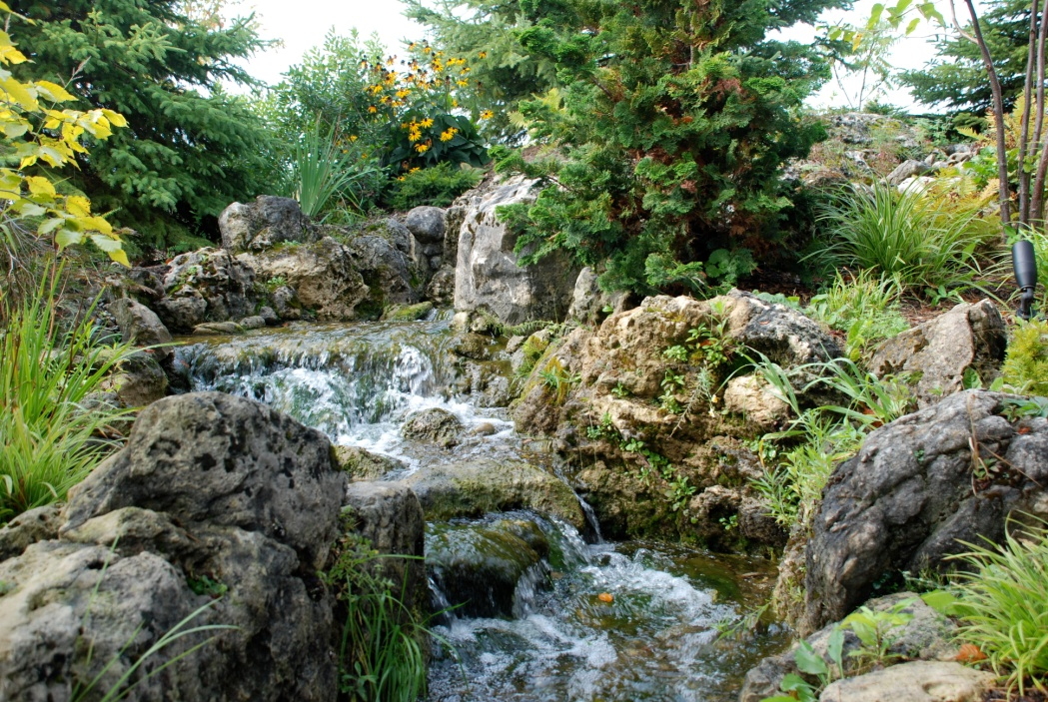
Water Features

Slide 21
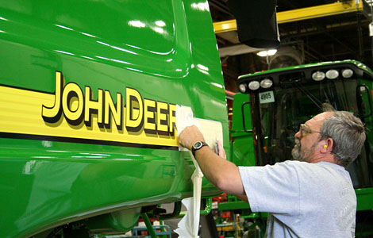
Industry Facts
Most firms are small business
Most staff work full time hours in a shorter period
Industry in Ontario has over 6000 Employers
Hundreds of Municipal Parks
Not to mention the support industries such as…..

Slide 22
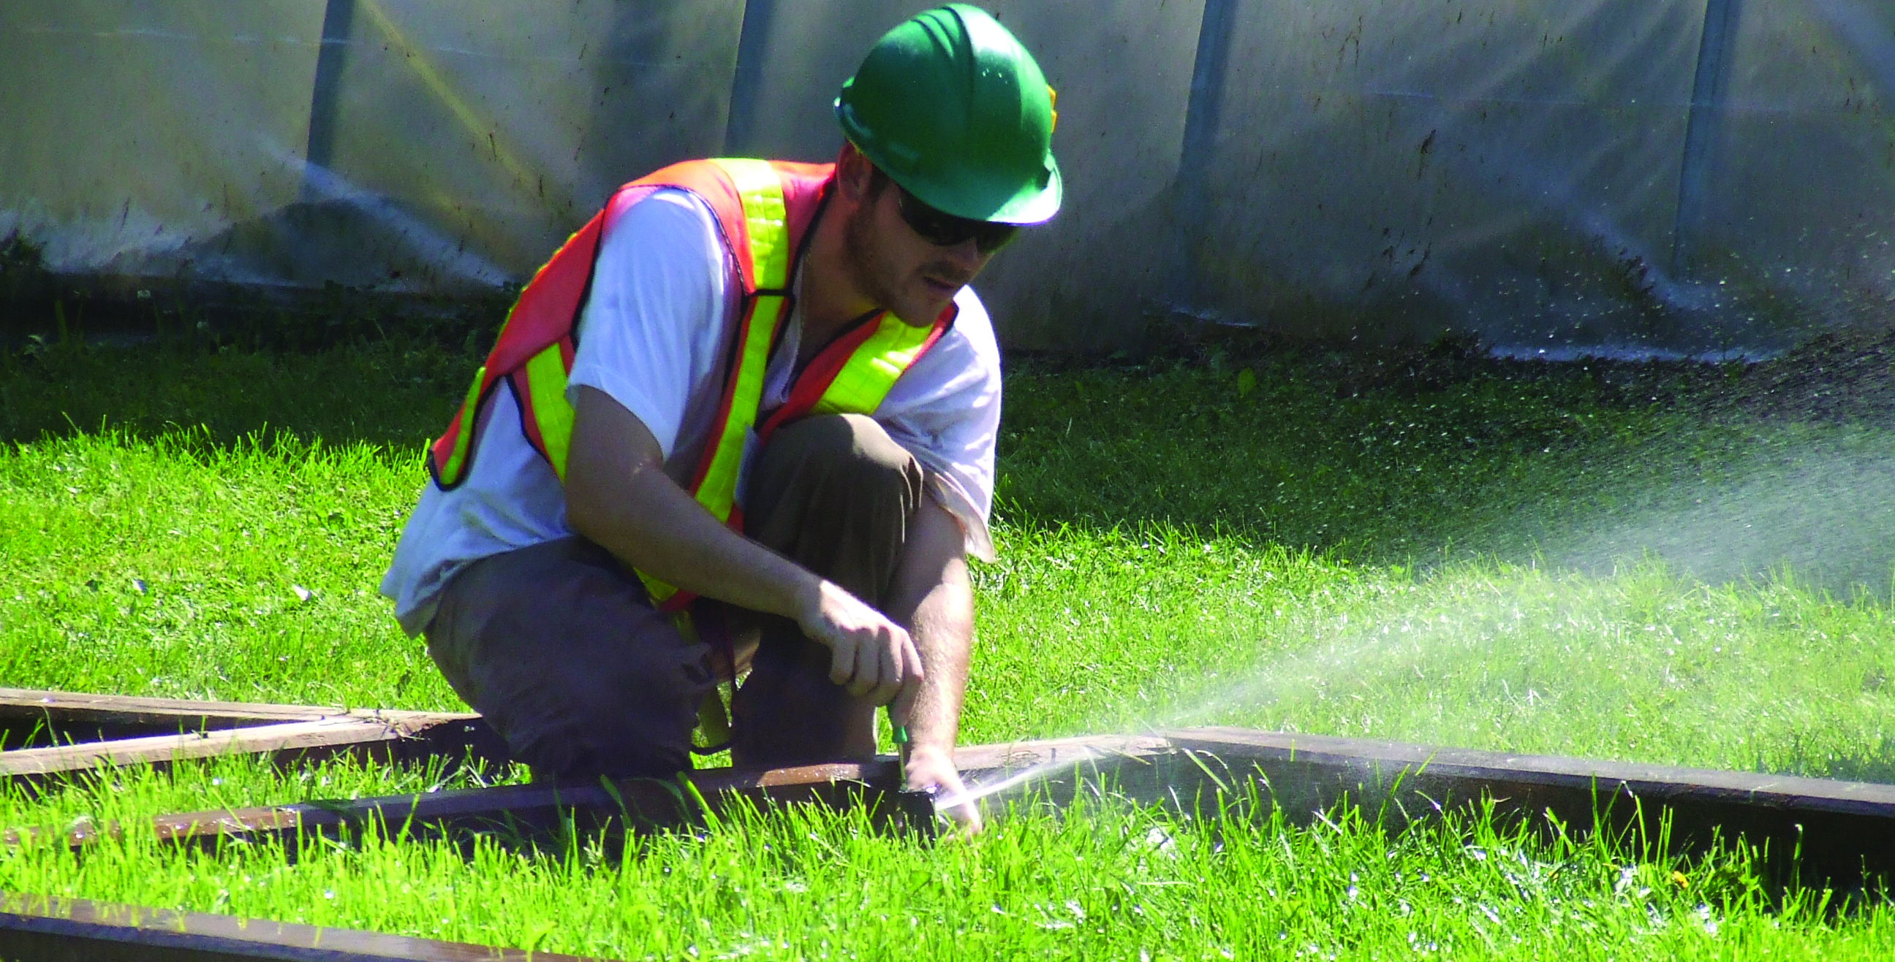
Essential Skills
for Landscape Skilled Worker
Math
Science
English
Business
Art
Communication – written and verbal
Mature Individual
Problem Solving & Decision Making
Job Task Planning & Organizing
Customer Service oriented
Professional
Physically Fit

Slide 23
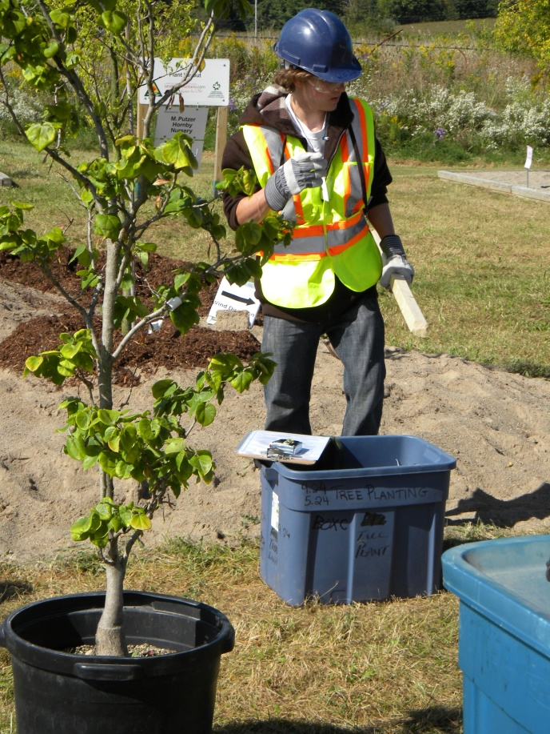
Work Habits
Working Safely
Teamwork
Reliability
Organization
Working Independently
Initiative
Self-advocacy
Customer Service
Entrepreneurship

Slide 24
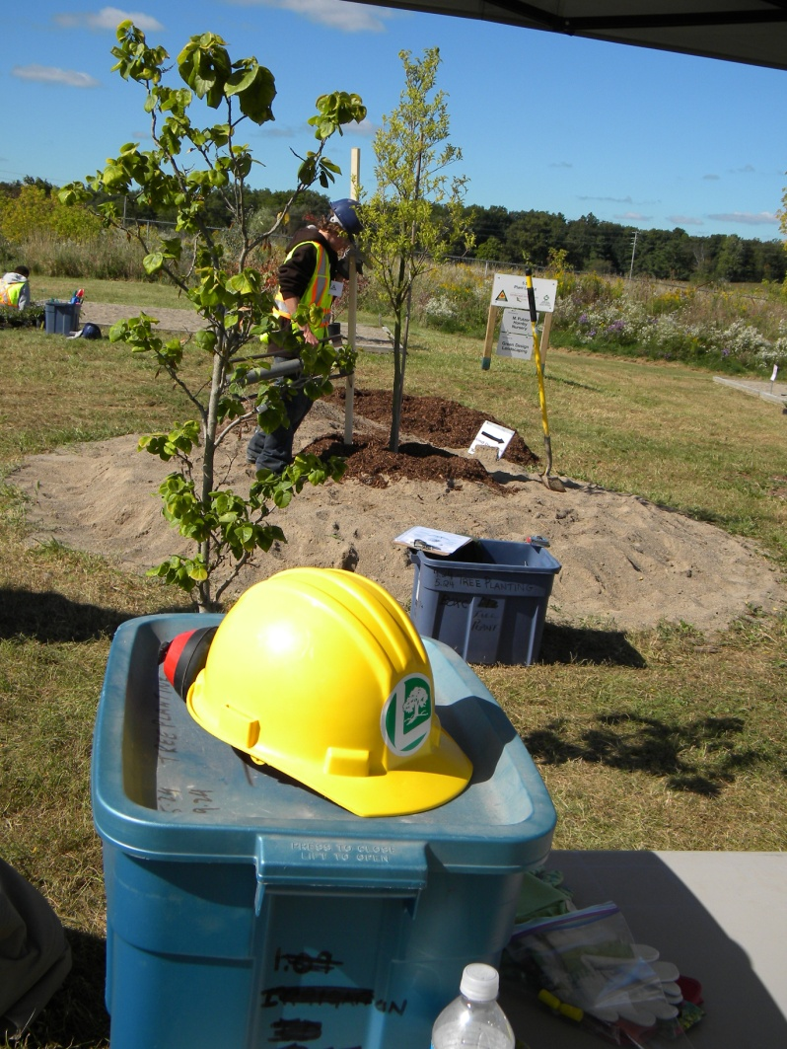
Safety
Commitment to personal and public safety is critical and required by law!
Unsafe workers put Employers at risk and therefore will not stay employed long
Young & New Worker heightened Enforcement Focus

Slide 25
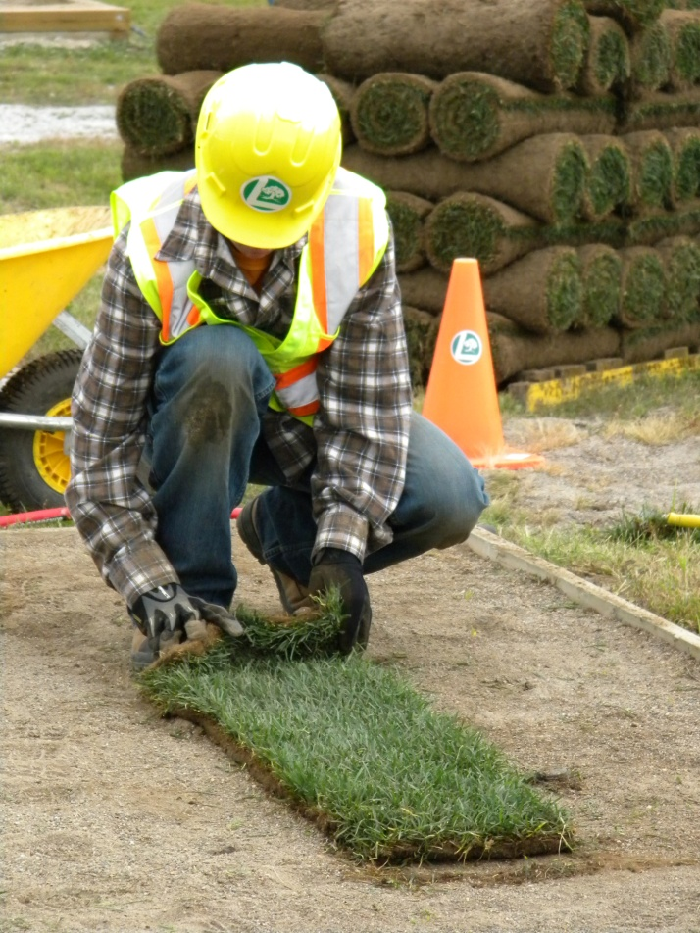
The Landscape Industry
Is an opportunity for anyone with:
Passion for plants and people
Love of outdoors
Desire to learn
Basic Essential Skills
Strong Work Ethic
Environmental responsibility

Slide 26
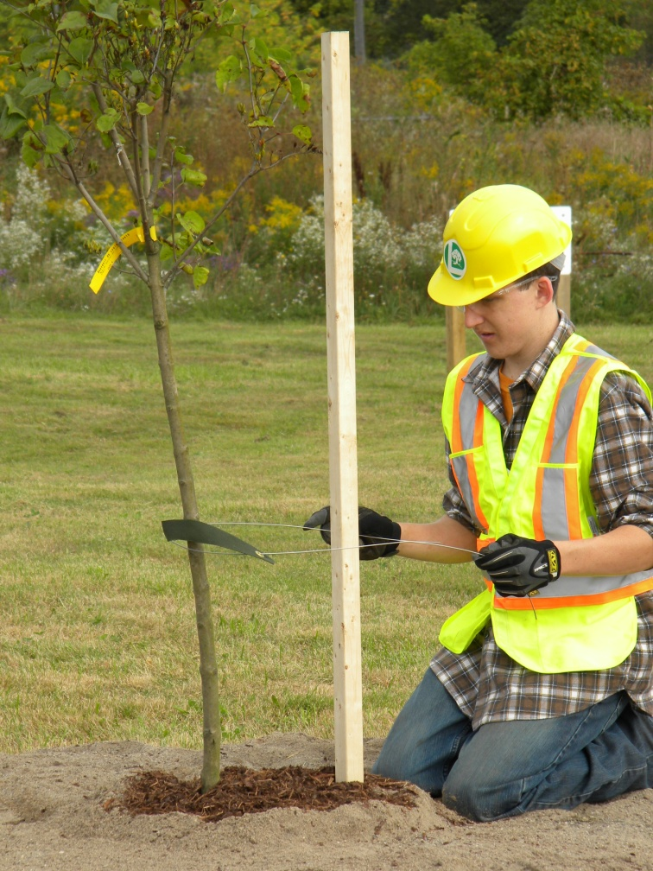
Pathways to Landscape Industry Success
Workplace
Apprenticeship
Certifications
College
University
Regardless of the pathway, to remain successful, a journey of life long learning
is a given

Slide 27
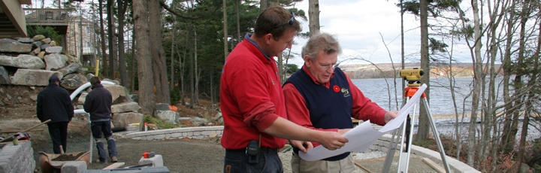
Opportunities for Advancement
Labourer
Skilled Worker Stone Mason, Horticulturist, Carpenter, Electrician etc…
Foreperson
Supervisor
Management
Design
Sales
Entrepreneurship

Slide 28
Landscape Horticulturist Apprenticeship
Level 1:
12 weeks in practical classroom over the winter
Level 2:
12 weeks in practical class room over the winter
= 24 weeks in practical classroom + 5400 hours of experience on the job

Slide 29

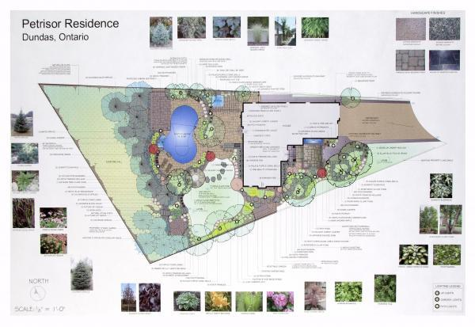
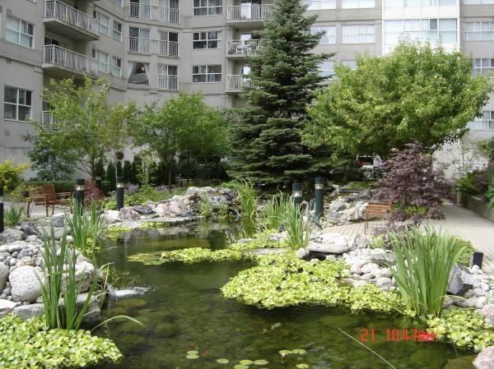
Certification
Landscape Designer :
Certified Landscape Designer CLD
Garden Centre
Certified Horticultural Technician CHT
- Retail
Technician:
Certified Horticultural Technician (CLT)
-Maintenance or Installation
Certified Horticultural Technician
- Interior Landscape CLT-I
Manager:
Certified Landscape Professional (CLP)
Other Certifications:
Certified Irrigation Technician CIT
Certified Lighting Technician (New)

Slide 30
Scholarships
Ten $400.00 scholarships for students taking Horticultural Apprenticeship within 2 years of graduating from high school
Five $1000.00 scholarships available for College or University 1st year students
www.foundation.landscapeontario.com

Slide 31
Classifieds
www.hortrades.com
post your resume or find a placmement
www.landscapeontario.com
to find a Professional Member/Employer in your area

Slide 32
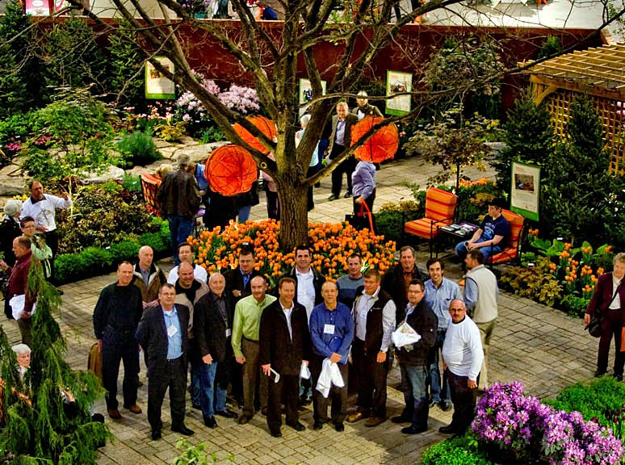
Join Us!
“Leadership is the capacity to translate
Vision into reality.”
Warren G Bennis

Slide 33
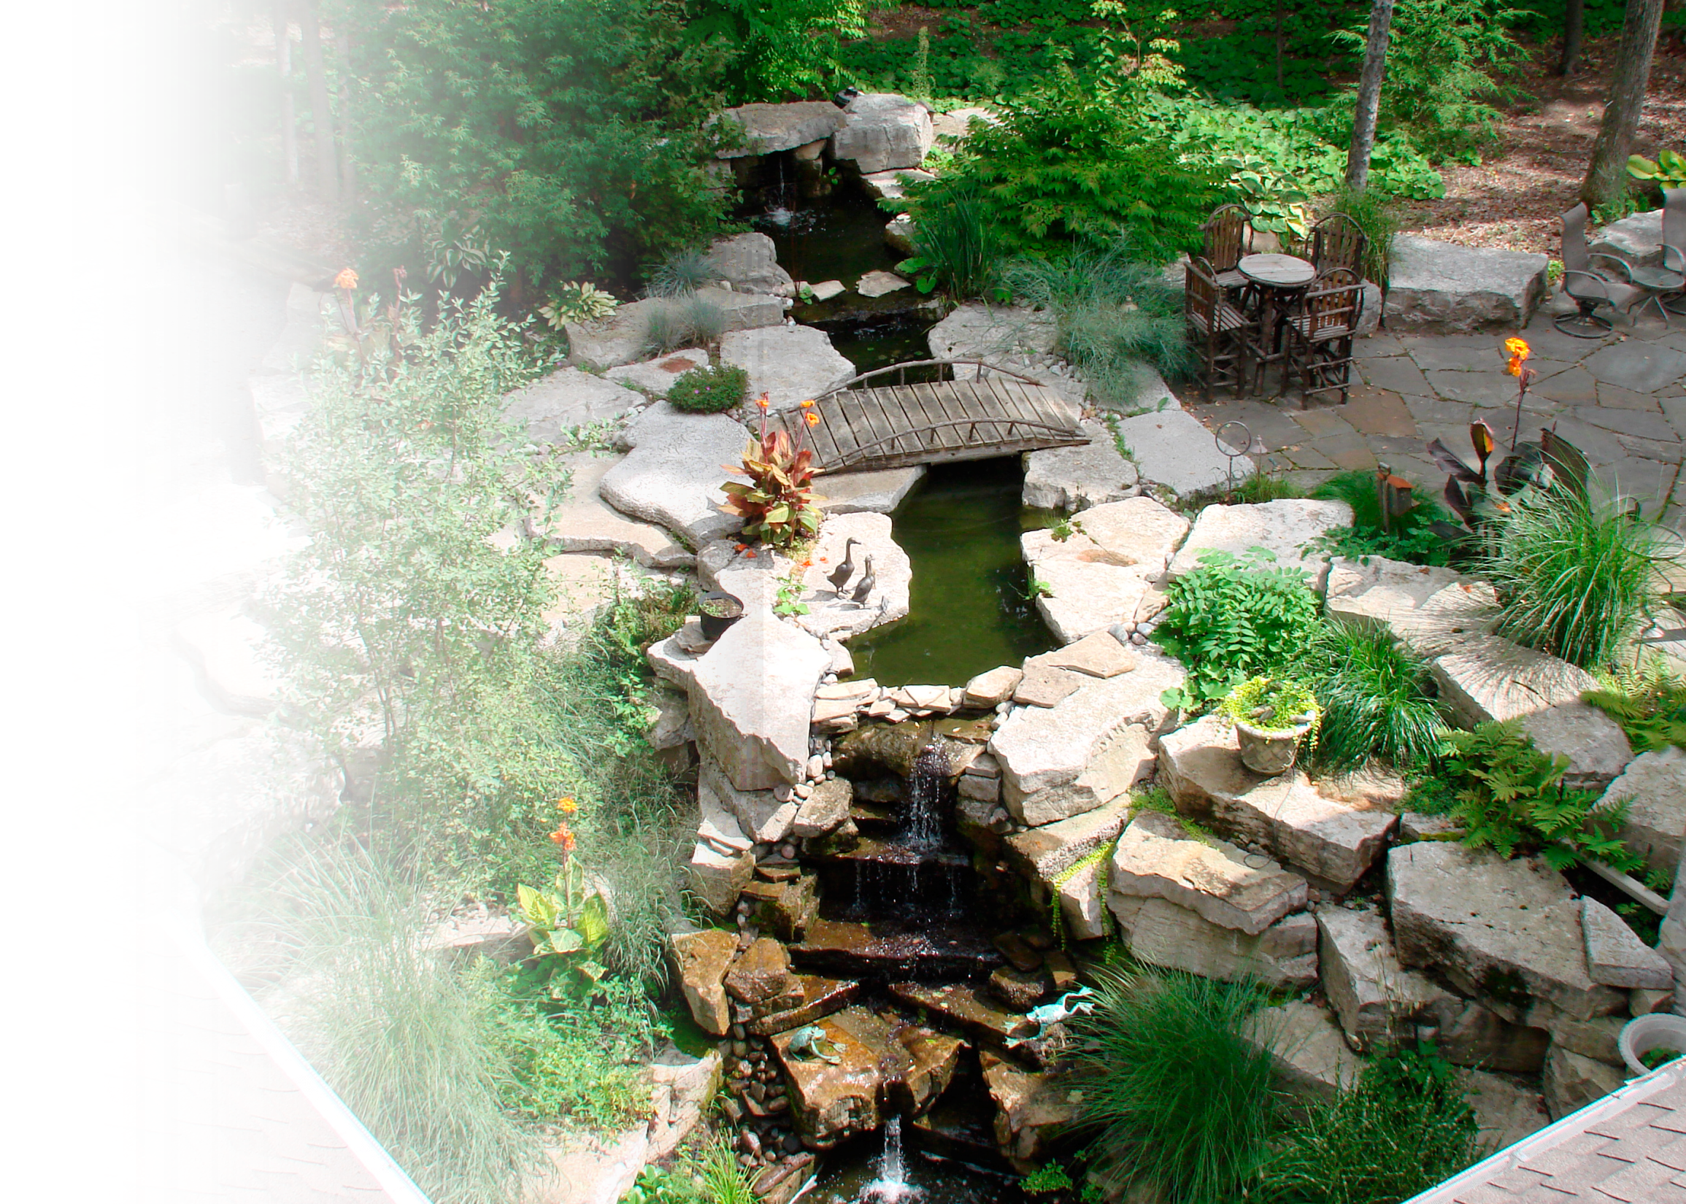
Start your career
in Landscape Horticulture today!
Contact:
•Landscape Ontario
www.hortrades.com
• High School Guidance Counsel
or
Contact a College/University
that offers
Landscape Horticulture
programs
• MTCU – For Apprenticeship

