Slide 1
Robert Roszell
Inventor of the TUFF TECH Bag, flexible rain barrels and the flexible brine maker.
In the snow and ice industry for 19 years dealing with liquids for pavements
Developed the first 4 in 1 truck for Wellington County
www.tufftechbags.com

Slide 2
Topics of discussion
Sayings and terms use in the snow industry
An over view of liquids
Landscape Ontario’s research project for 2010-2013

Slide 3
Does wind chill effect the melting power of salt on a snow covered parking lot?
Notes:
Listening to a radio station stating the temperature is -6’ C but feels like -29’c

Slide 4
Dictionary definition
Still-air temperature that would have the same cooling effect on exposed skin as a given combination of temperature and wind speed. As the wind speed increases, the wind chill equivalent temperature decreases; e.g., an air temperature of 30 °F ( – 1.1 °C) with a wind speed of 20 mph (32.2 kph) produces a wind chill of 17 °F ( – 8 °C). Wind chill is often included in weather reports to describe how cold it feels.
Notes:
So wind chill does not effect equipment or pavement. It is meant for humans

Slide 5
How cold is it?
It was cold enough to freeze the balls off a brass monkey!
Notes:
This is a pirates term. The pirate ship had cannon balls. They were stacked on a brass monkey to keep them from falling over. Because the brass expanded and contracted fatser than steel. It would shrink so much the balls would then fall off the brass monkey.

Slide 6
Does ground temperature effect the ability of salt to melt a snow covered parking lot?

Slide 7
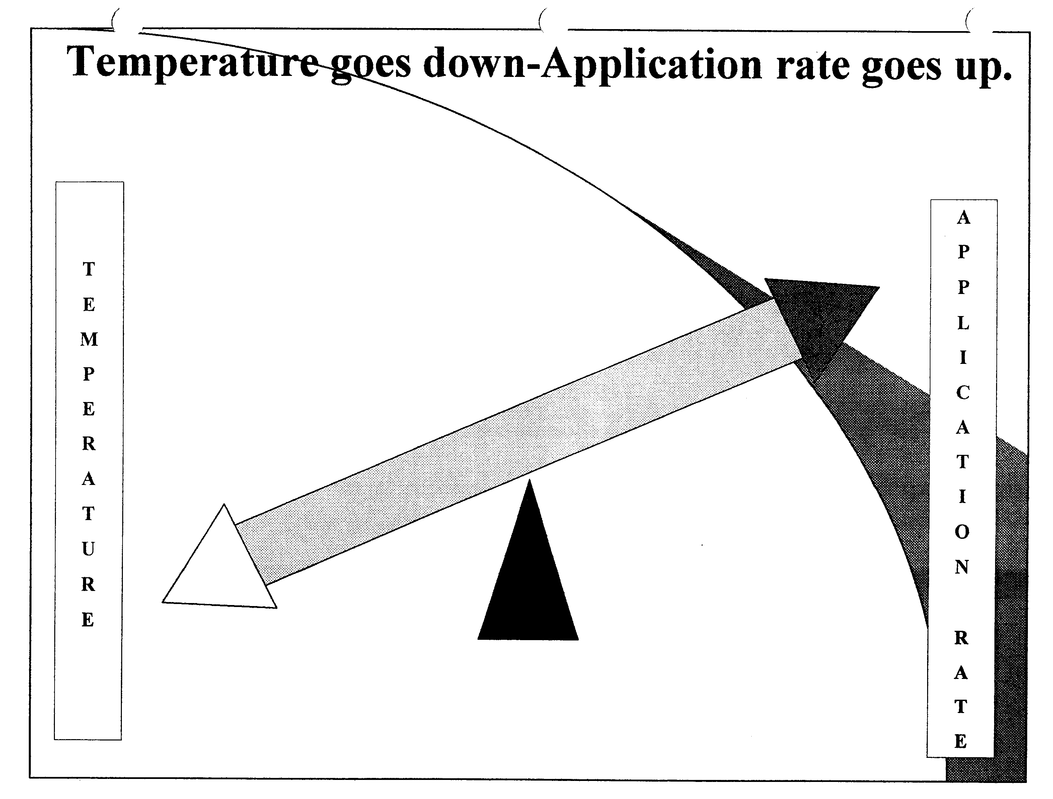
Notes:
Yes as the temperature goes down your application rate should be going down
The temperatures when it snows are usually just below freezing. This is due to the cloud cover.
The temperature usually drop drastically when the clouds move on and the sun shines.
This is usually helpful because of the solar heating of the pavementg.

Slide 8
What is the biggest concern effecting the environment, salt or chlorides?
Notes:
There are many studies on the subject and it is chlorides is the most toxic to plants.
Damage vegetation.
• Change the soil structure
Mike Stone just finished a report on water run off from a parking lot where chlorides spike 10 times more chlorides when the contractor changed from salt to a mixture of material
About 1 teaspoon of salt can pollute 5 gallons of water forever. This applies to all chlorides.

Slide 9
Salt brine is the most used liquid for anti-icing or prewetting.

Slide 12
Prewetting is to apply any liquid to dry salt or sand prior to spreading.
Notes:
We are mostly familiar with salt being sprayed with a salt brine or mixture.
European countries are using heated water on sand. This allows the sand to in bed itself in the ice
Prewetting reduce the scatter of salt on highways up to 30% reduction was noticed.
All the cities and municipalities then said they saw a 30% reduction even when they were travelling slow
Application rate for prewetting as per MTO is 5%.

Slide 13
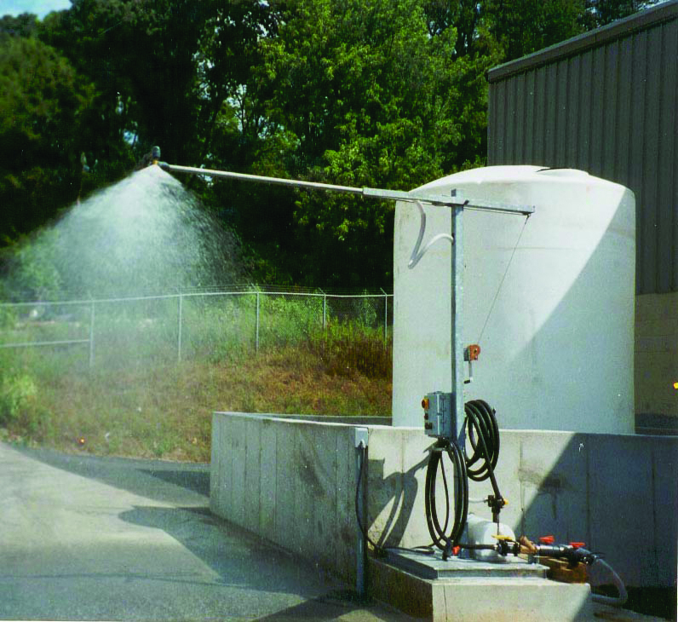

Slide 14
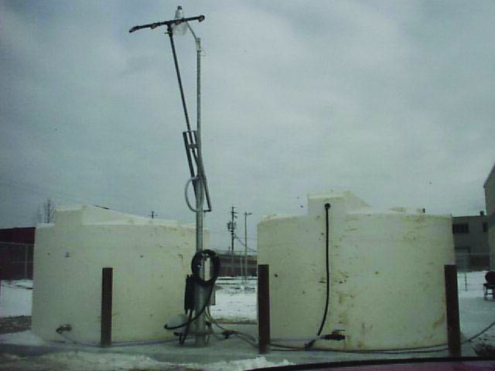

Slide 16
Anti-icing is the process of applying liquids to the road surface prior to a snowstorm.

Slide 17
Studies by various agencies and institutions have identified several benefits of a sound anti-icing strategy:
-by preventing snow or ice from bonding to pavement,
removal and control of snow is much easier
-material is applied ahead of the storm, making it safer for equipment and operators
-lower material application rates compared to de-icing operations
-the need for sand or other abrasives is reduced
-cleanup of sand or other abrasives is reduced
-reduced environmental impact.

Slide 19
Landscape Ontario’ s research project for standardization of salt application rates
Notes:
5 years of discussing rates
Insurance industry not fighting claims

Slide 20

Open Loop Operations
Signal
Motor
Control

Slide 21

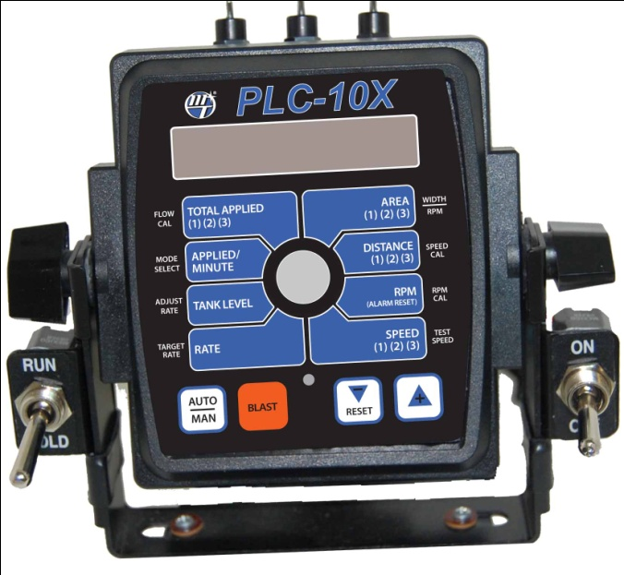
Closed Loop Operations
Signal
Motor
Sensor
PLC-10X
Controller
Return Signal

Slide 22
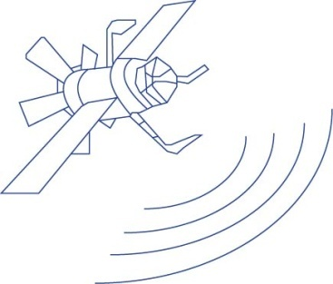
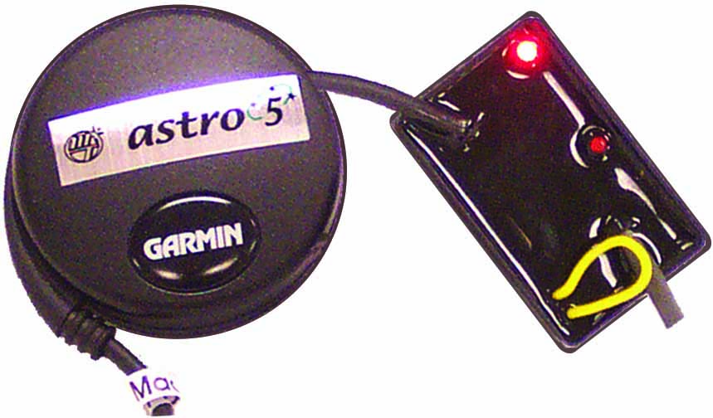

Closed Loop Ground Speed Operations
GPS Input
Signal
Motor
Astro 5
Sensor
Return Signal
PLC-10X
Controller

Slide 24

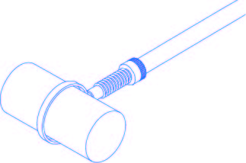
Closed Loop Ground Speed Spinner Compensation
GPS Input
Signal
Motor
Astro 5
Sensor
Return Signal
Spinner Motor
& Sensor
PLC-10X
Controller
2-Way Signal

Slide 25
Road application rates are measured in kilograms per 2 lane highway. Such as 130kg/ km.
What application rate do we use for
for parking lots?
Notes:
This is where we have a challenge. The amount if you ask a landscaper is the total.
If you are not a landscaper you may think we just dump the salt in a pile
We plan in using kilograms per 1,000 square meters or pounds per 1,000 square feet.

