Slide 1

Careers in
Landscape Horticulture

Slide 2

Careers in
Landscape Horticulture
Choose from a wide diversity of rewarding jobs
Work in a healthy environment
Have a career with advancement opportunities
Be financially independent
Do something creative and meaningful that people will enjoy for years to come
With your two hands, you have the ability to make the world a greener, more beautiful place!
Gardening is North America’s #1 leisure-time activity… we get paid to do it everyday!

Slide 3

Is a provincial Association with over 2400 Member firms with over 10,000 employees
“Landscape Ontario’s mission is to be the leader in representing, promoting and fostering a favourable climate for the advancement of the horticultural industry in Ontario”

Slide 4


Is a program developed by L.O., defining our members as the GREEN Industry working together to promote the joys and benefits of plants and landscapes.
Our Motto is: ‘ Lets Landscape Ontario, with Green For Life!’

Slide 5
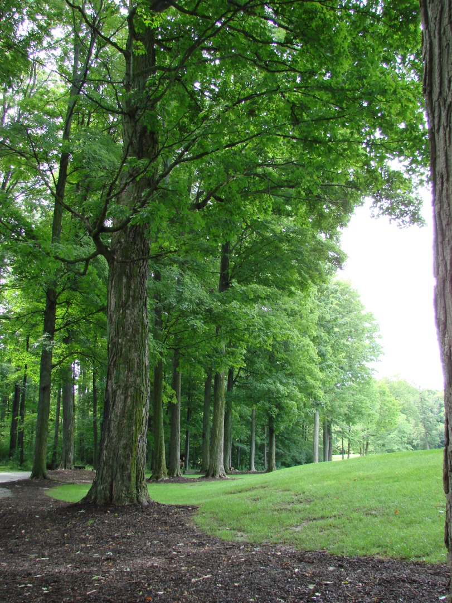
Landscape Horticulture Industry
Contributes over $14 Billion to the Canadian Economy
Over 130,000 employed today
Ontario represents over 50% of the Canadian Industry.
Busy, knowledgeable consumers want instant quality landscapes
No other industry enhances the environment better!
The original green industry
“Colour it green with trees”
(author unknown)

Slide 6
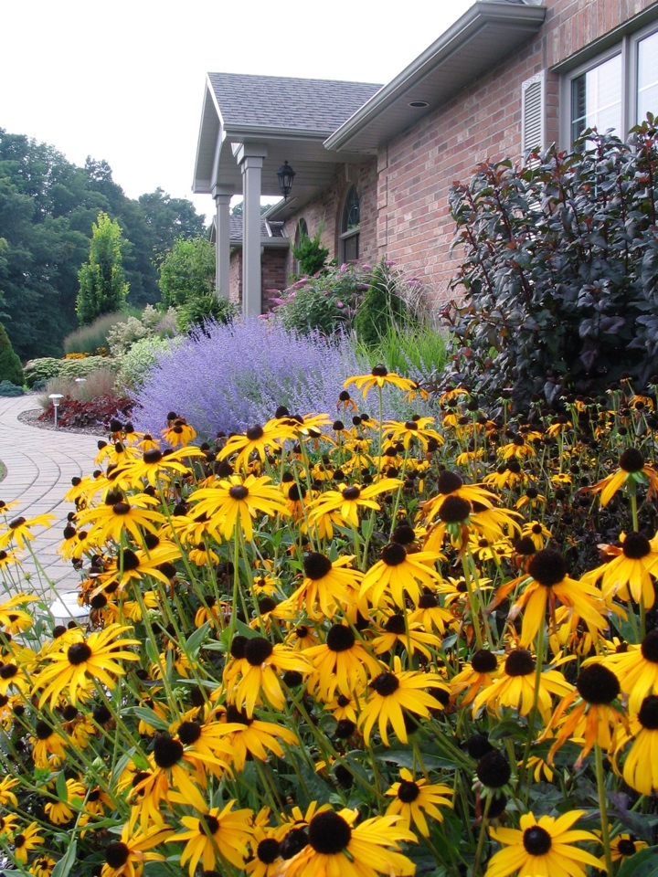
Landscape Horticulture Industry
Is a growing industry - literally!
Is expected to double in size by 2021
50% of the industry is expected to retire in the next 5-10 years, leaving a huge gap in the number of skilled workers required to meet the growing needs of green spaces
Every day is EARTH DAY!
“Plan and Plant for a Better Tomorrow” (J.C. Raulston)

Slide 7
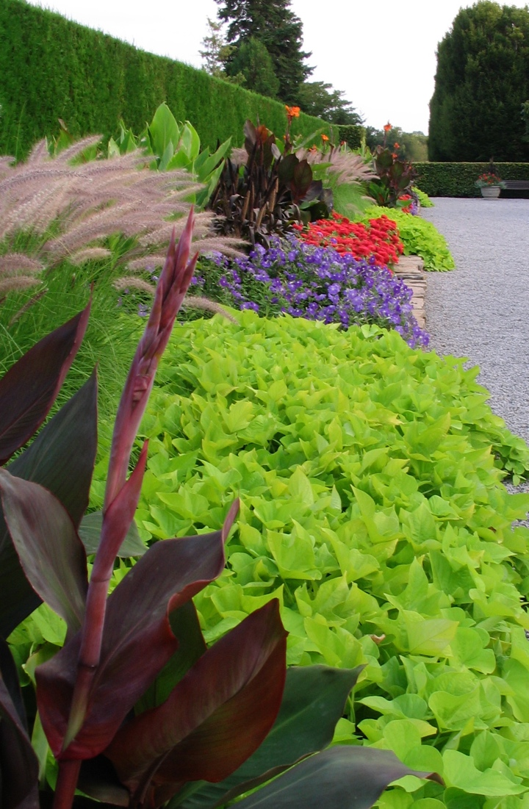
Great career opportunities
3 distinct sectors
Nursery / Production
Garden Centre
Landscape

Slide 8
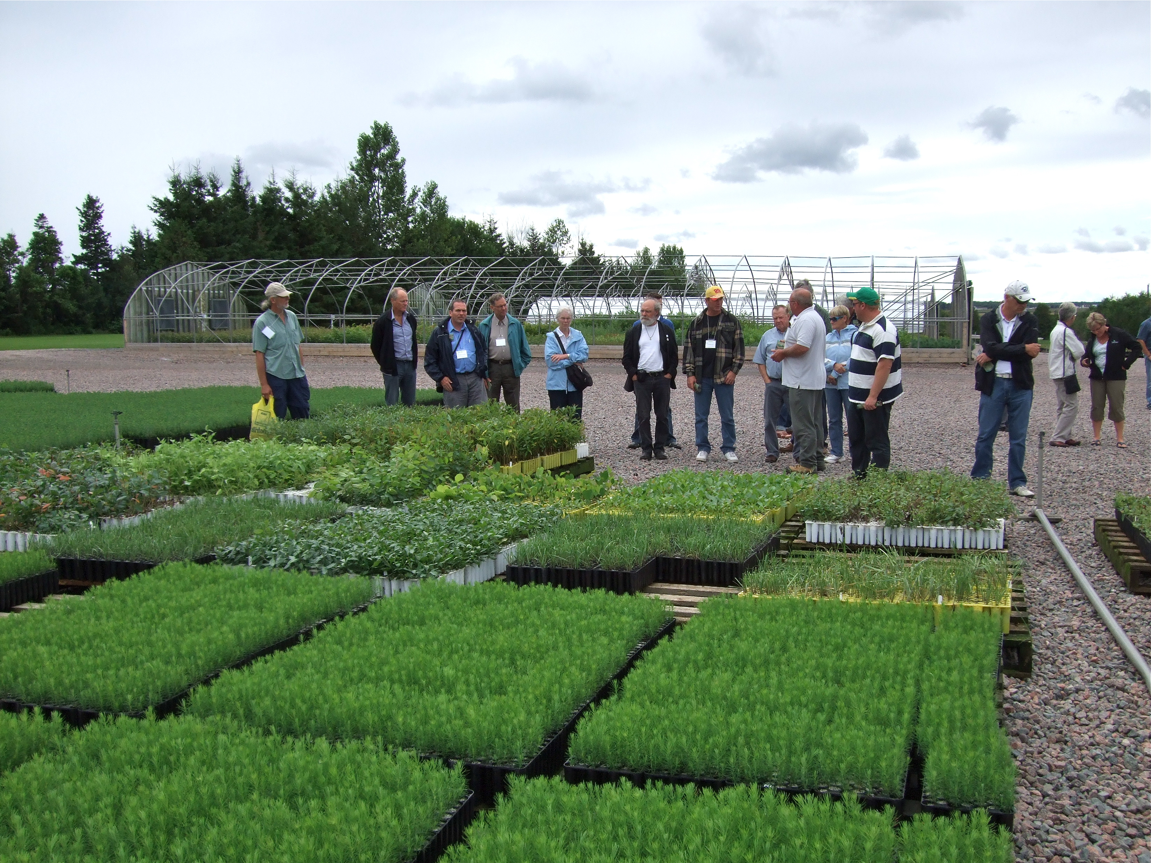
Nursery Production
Plant Propagator
Inventory Controller
Field Foreperson
Field Superintendent
Soil or IPM Specialist
Manager
Salesperson
Sales Manager
Shipping Foreperson
Broker

Slide 9
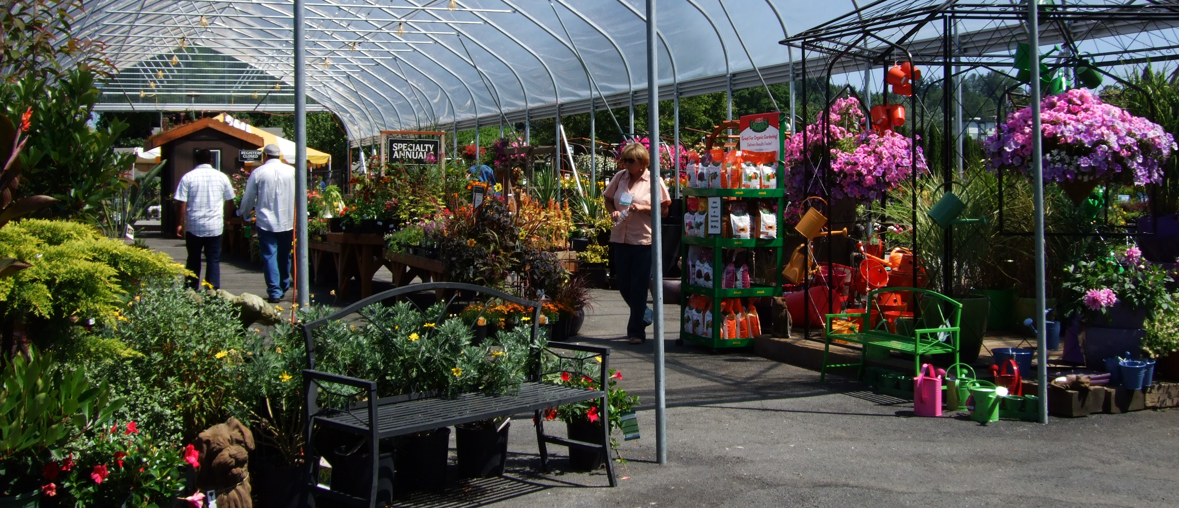
Garden Centre
Buyer, Merchandiser, Salesperson
Manager, Greenhouse Manager
Specialists: Perennials, Nursery Stock, Promotion and Marketing Specialists

Slide 10
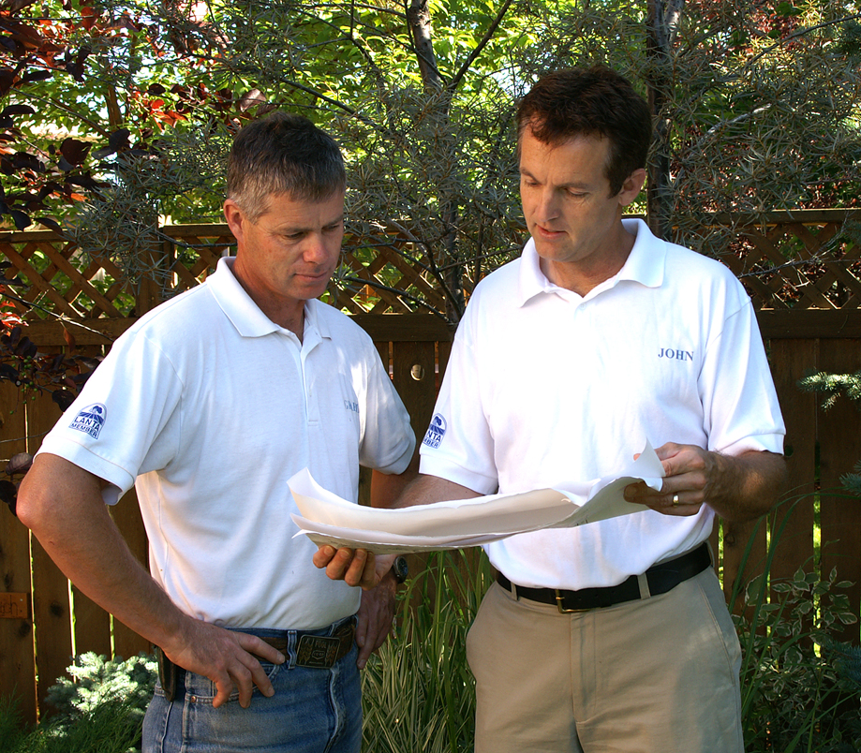
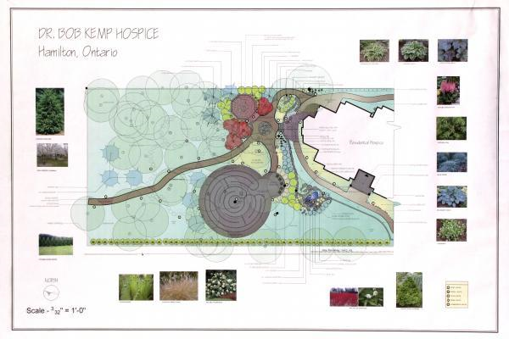
Landscape Architect and Designer
Landscape Architect
Landscape Designer
Draftsperson
Estimator

Slide 11
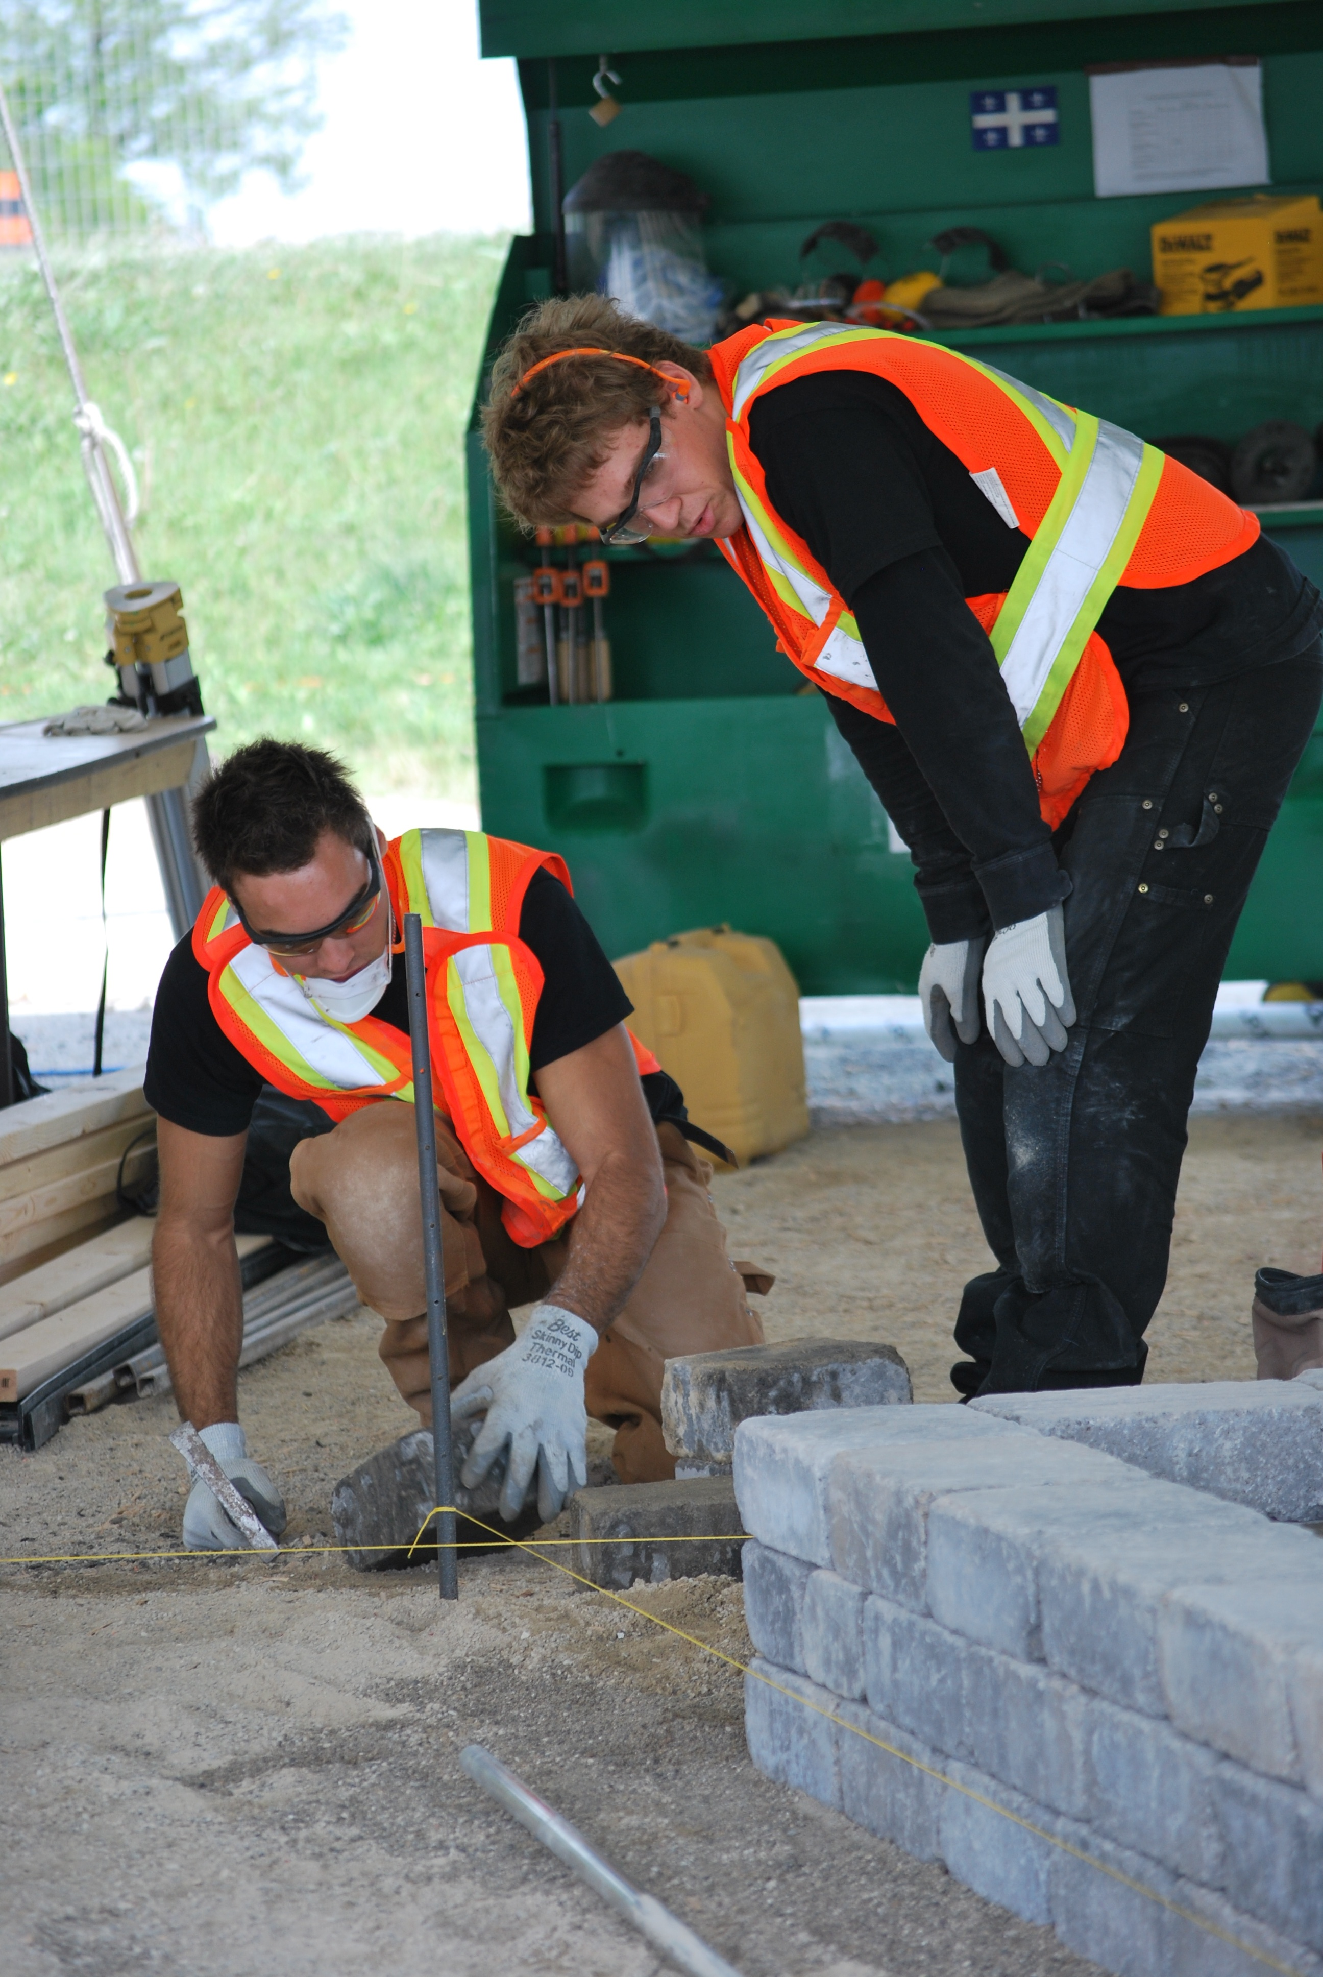
Landscape Contracting
Manager
Construction Foreperson
Construction Supervisor
Salesperson
Stone Mason
Carpenter
Landscape Technician

Slide 12
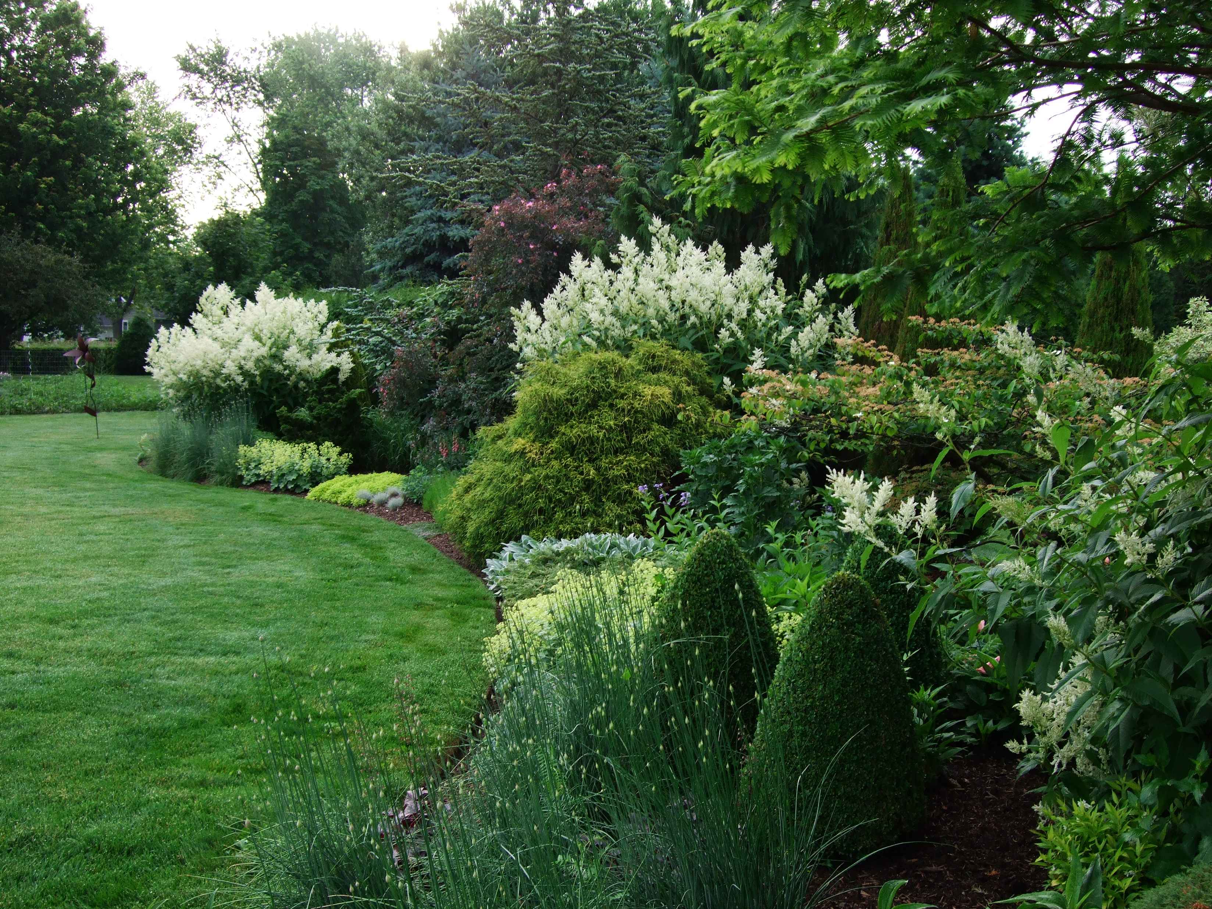
Grounds Management and Lawn Care
Horticulturist
Supervisor
Foreperson
Crew Leader
Gardener
IPM Technician
Sales Representative
Estimator
Equipment Operator
Turf Specialist

Slide 13
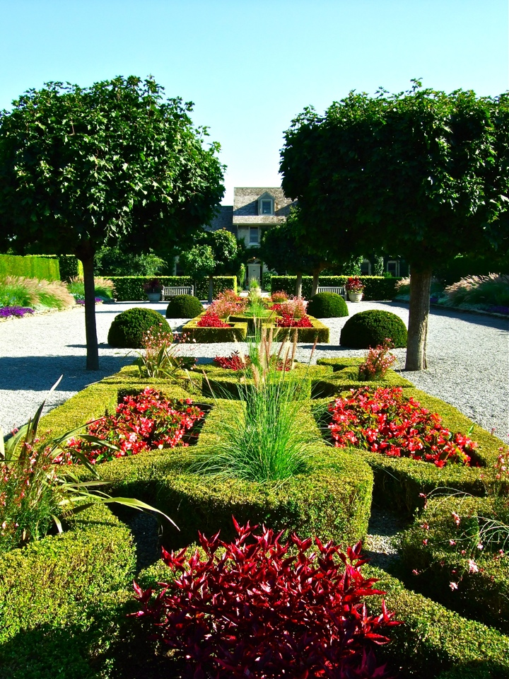
Parks & Recreation
Executive Director of Parks
Operations Manager
Superintendent of Parks
Horticultural Technician
Park Planner
Greenhouse Manager
Curator
Gardener
Horticultural Foreperson
Horticulture Supervisor

Slide 14
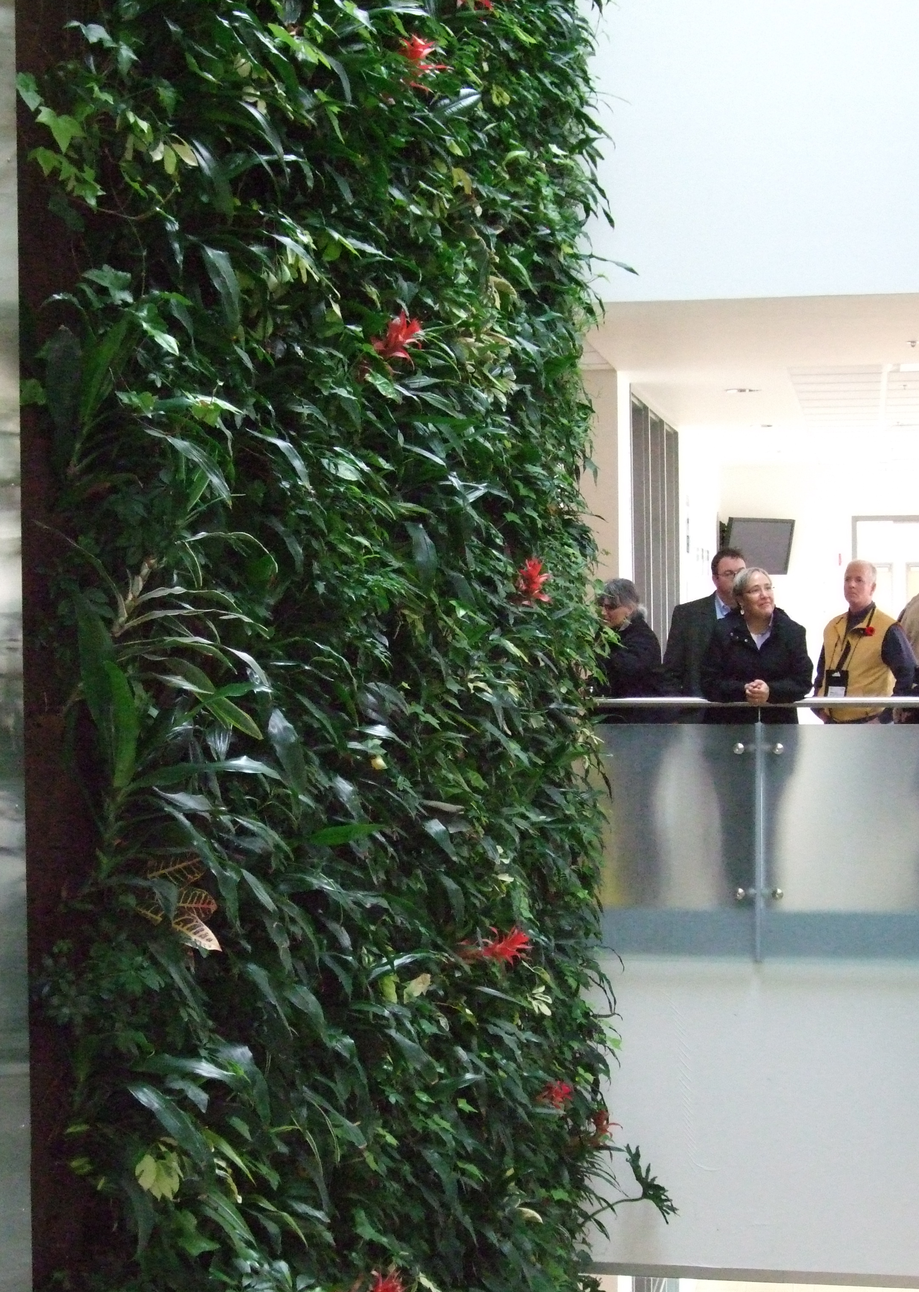
Interior Plantscaping
Grower
Salesperson
Construction Foreperson
Maintenance Supervisor
Crew Member

Slide 15
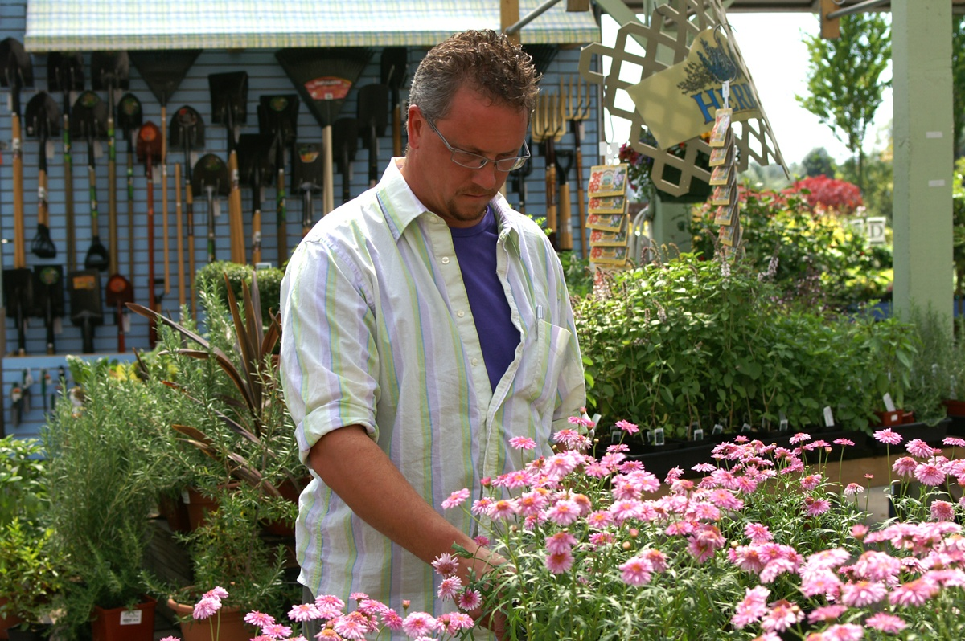
Floriculture
Grower
Production Superintendent
Marketing Manager
Inventory Controller
Buyer
Floral Designer
IPM Specialist
Wholesale Florist
Salesperson

Slide 16

Irrigation Contracting
Technician
Irrigation Auditor
Designer
Irrigation Installer
Sales Representative

Slide 17

Golf Courses
Golf Course Superintendent
Assistant Superintendent
Golf Course Technician
Equipment Operator, Turf Specialist
Horticulturist, Gardener

Slide 18
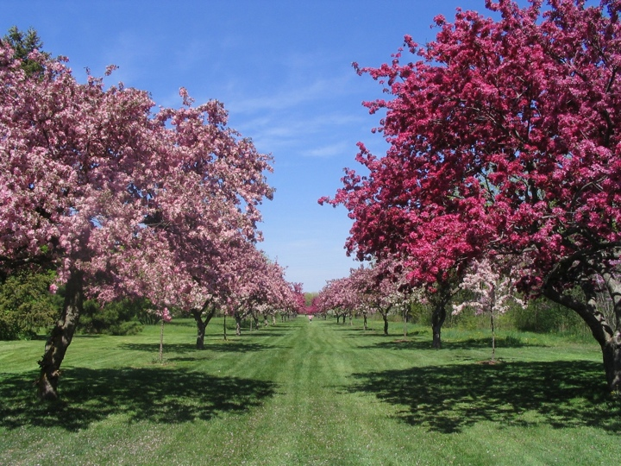
Botanical Gardens and Arboreta
Educational Director
Plant Propagator
Librarian
Horticulturist
Curator
Gardener
Instructor
IPM Specialist
Plant Pathologist
Plant Entomologist
Conservation Manager

Slide 19
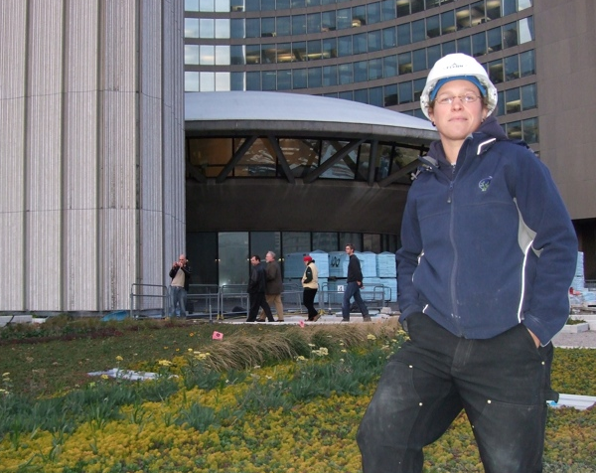
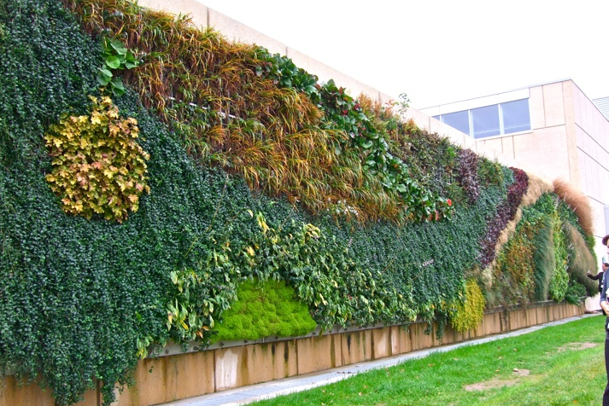
Green Roofs and Green Walls
Designer
Technician
Horticulturist
Gardener
Notes:
Top right Green Roof at City Hall, Toronto, Ontario
Bottom Left: Canada’s first cold climate exterior wall, Nova Scotia Community College, Halifax, Nova Scotia…planted by horticulture students

Slide 20
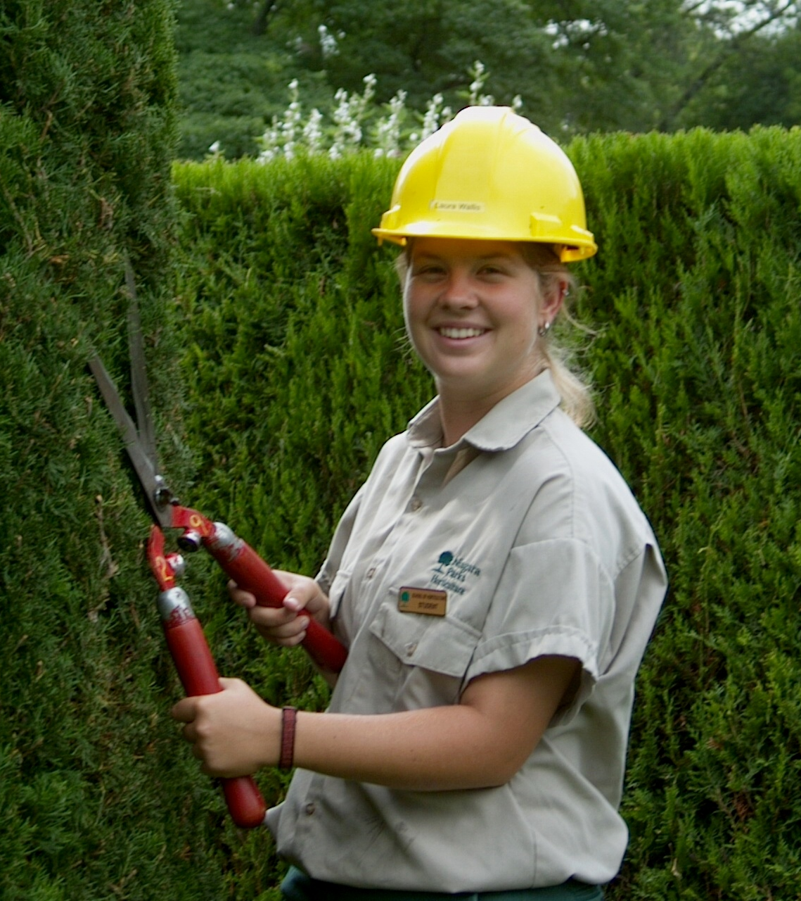
The Landscape Horticulture Industry
Opportunities for anyone with a:
Passion for plants and people
Love of outdoors
Desire to learn
Technical Essential Skills
Strong Work Ethic
Entrepreneurial spirit
Environmental responsibility

Slide 21
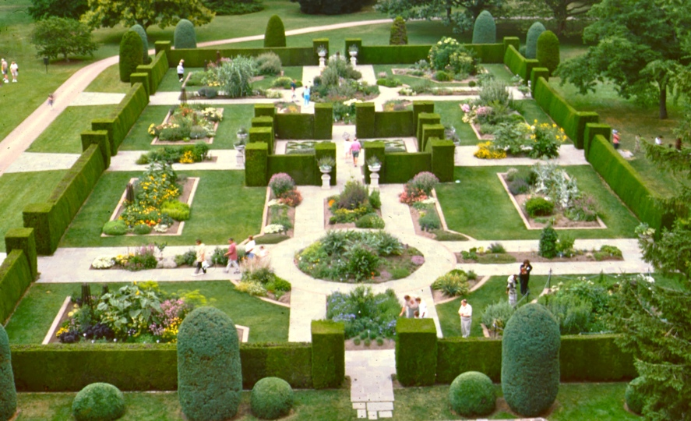
Many Pathways to success…..
Workplace
Certificates
Apprenticeship
College
University
Industry
Certifications
Regardless of the pathway, to be successful
learning is a life long journey!

Slide 22
Apprenticeship
Landscape Horticulturist was the 50th trade to receive Red Seal status in 50 years of the Red Seal program in 2010
Focus on practical on-the- job training during the gardening season
In-class time is during off-peak season times
www.caf-fca.org
Resources for youth, apprentices, researchers, educators and employers

Slide 23
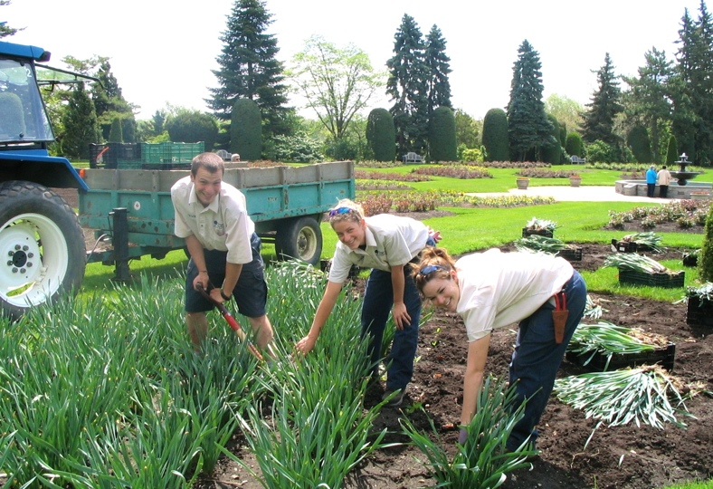
Colleges and Universities
www.ontariocolleges.ca
www.accc.ca
Association of Canadian Community Colleges and Institutes

Slide 24
Colleges and Universities
www.canadian-universities.net
Canadian universities, community colleges, career colleges and jobs in Canada
www.aucc.ca
Association of Canadian Universities - programs and scholarships
www.schoolfinder.com
helping students find schools and schools find students
www.campusstarter.com
Universities, colleges and private career colleges
www.agritalent.ca
225 training and educational programs across Canada

Slide 25

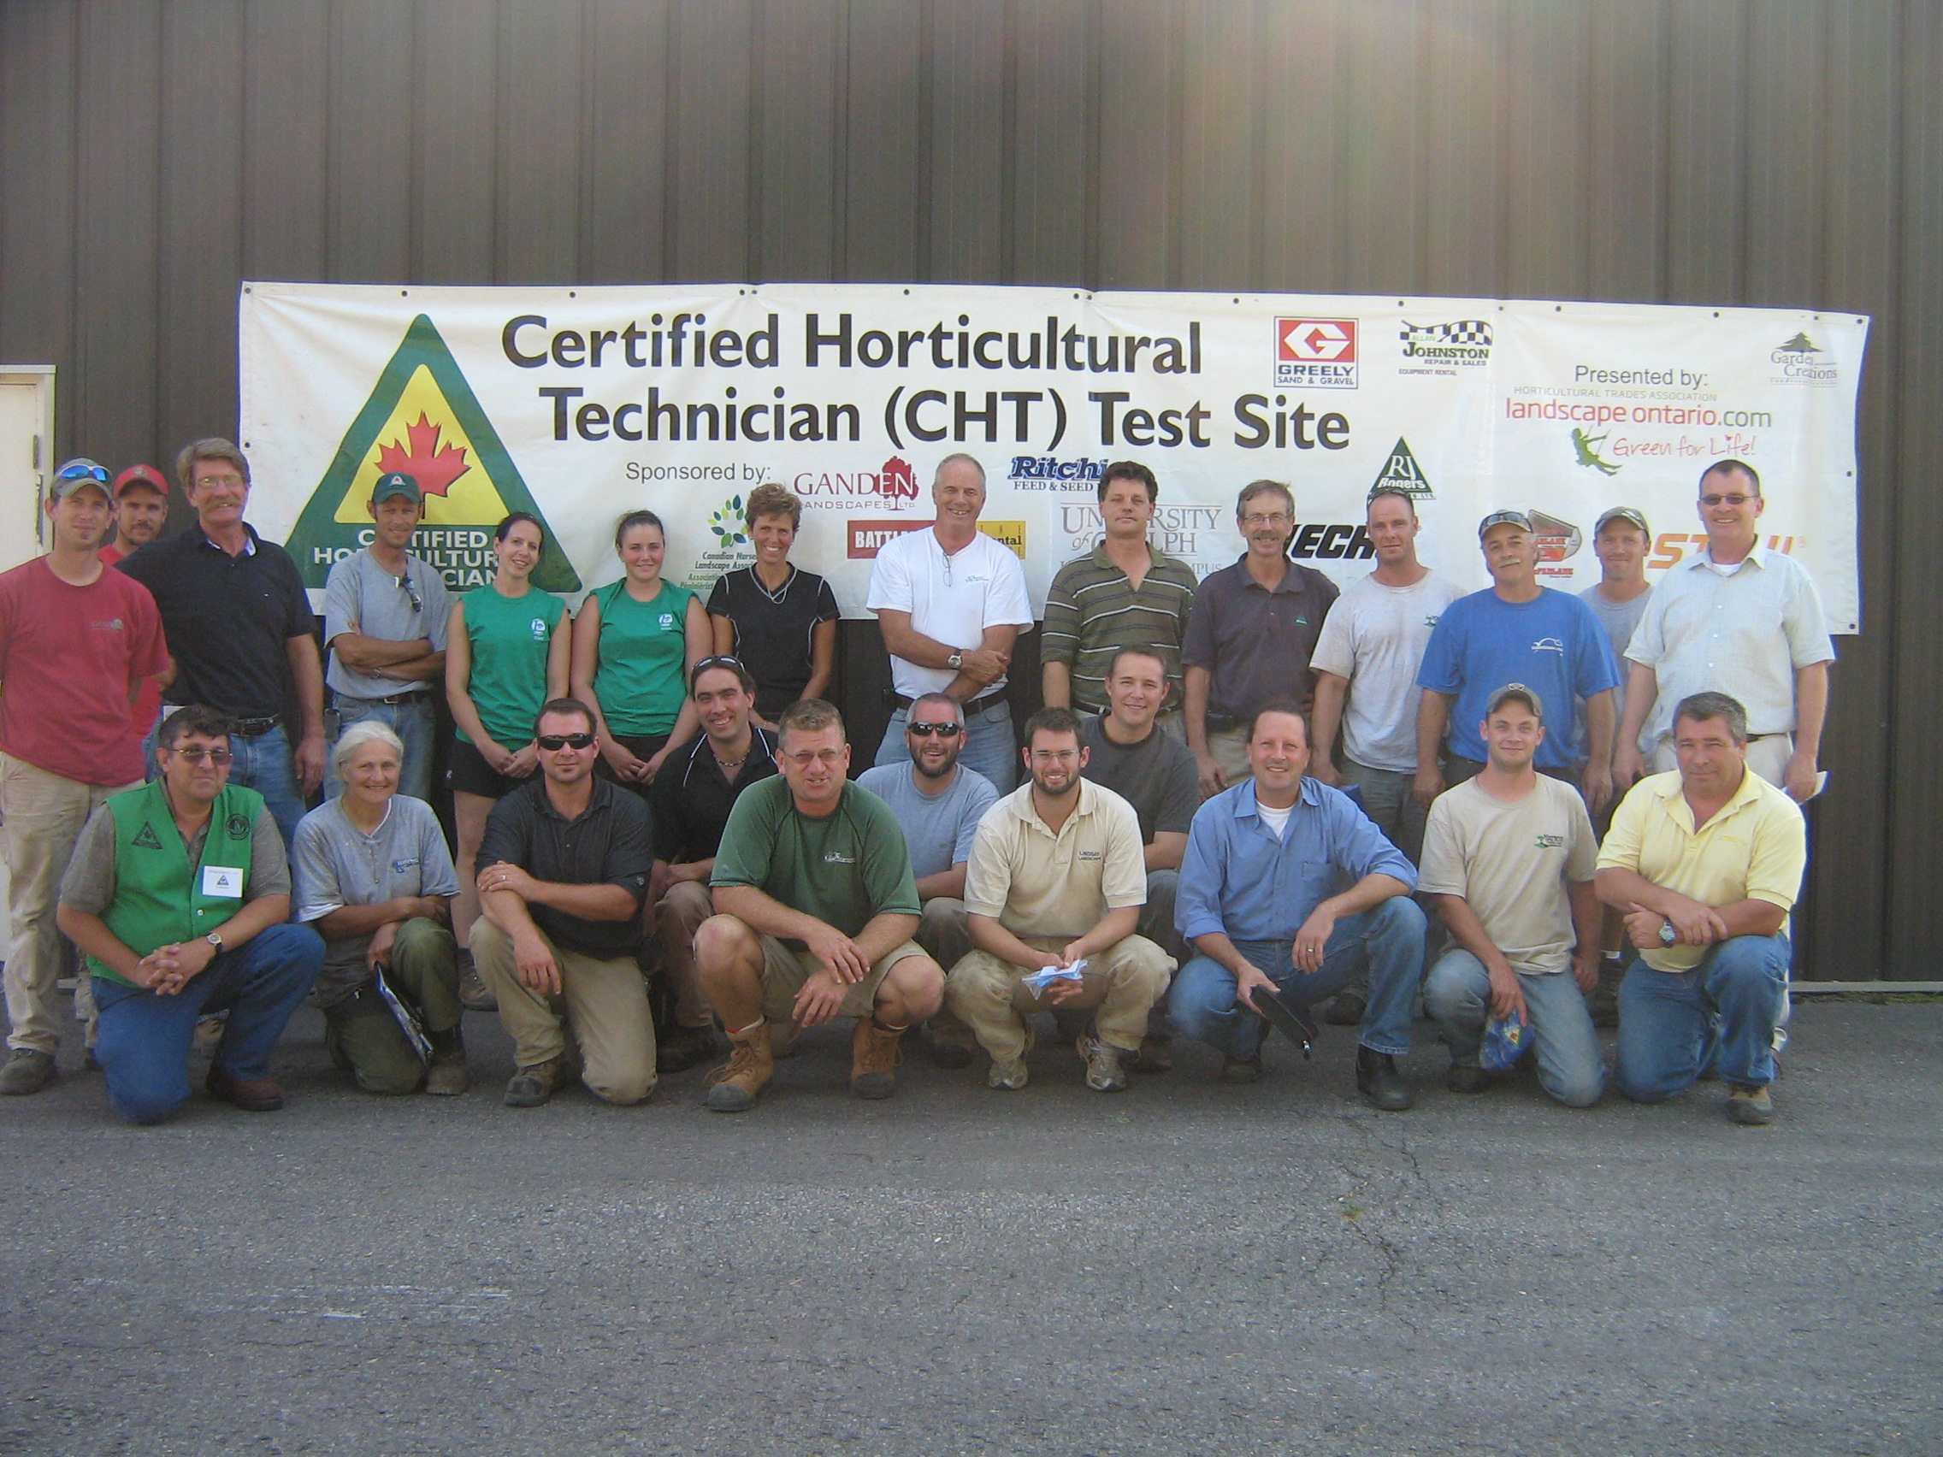
Certification
Technician (CLT)
  Hardscape Installation
  Softscape Installation
  Turf Maintenance
  Ornamental Maintenance
  Retail Horticulturist
  Interior Plantscaping
Designer (CLD)
Manager, Interior or Exterior (CLP)

Slide 26
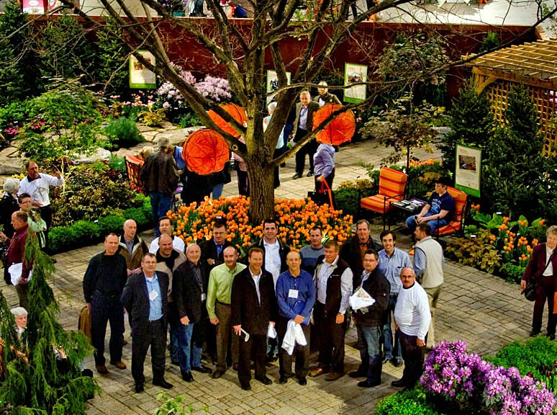
Join Us!
“Leadership is the capacity to translate
Vision into reality.”
Warren G Bennis

Slide 27
Start your career in
Landscape Horticulture today!
Contact CNLA
www.canadanursery.com
click on Green Industry Careers and Professional Development
Contact your local association:
www.

Slide 28
